Slide 1




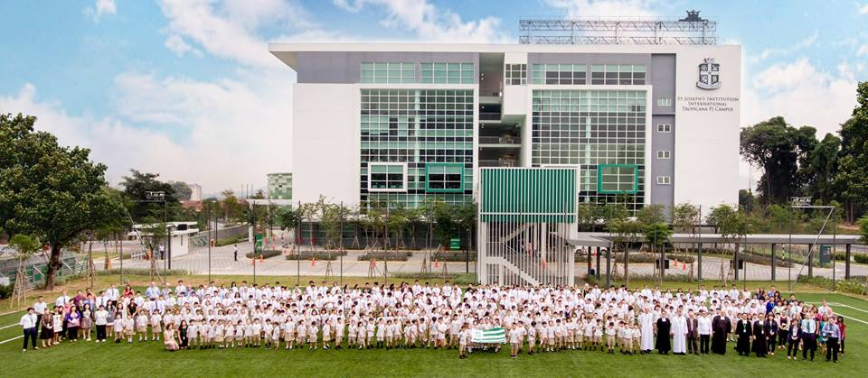

Enter to Learn, Leave to Serve

Slide 2

P3
Mission
P4
Letter from the Principals
P5
Our Vision
P6
History and Lasallian Heritage
P7
Organisation and Curriculum
P8
Learning Environment
P9
Pastoral Care
P10
Co-curricular Activities
P11
Life Long Learning
P12
Appointment Process
P13
Location Details
P14
Contact Details

Slide 3

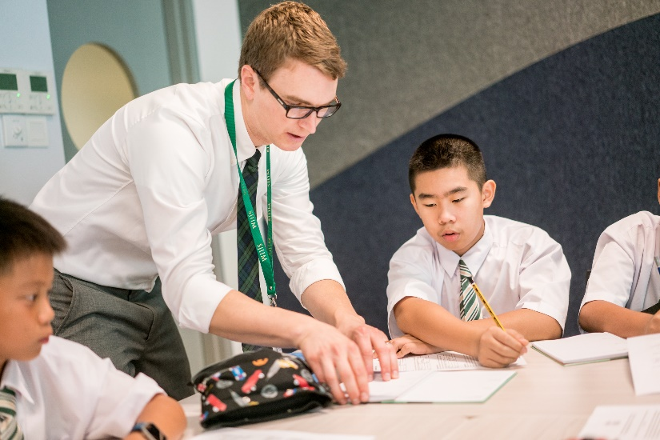
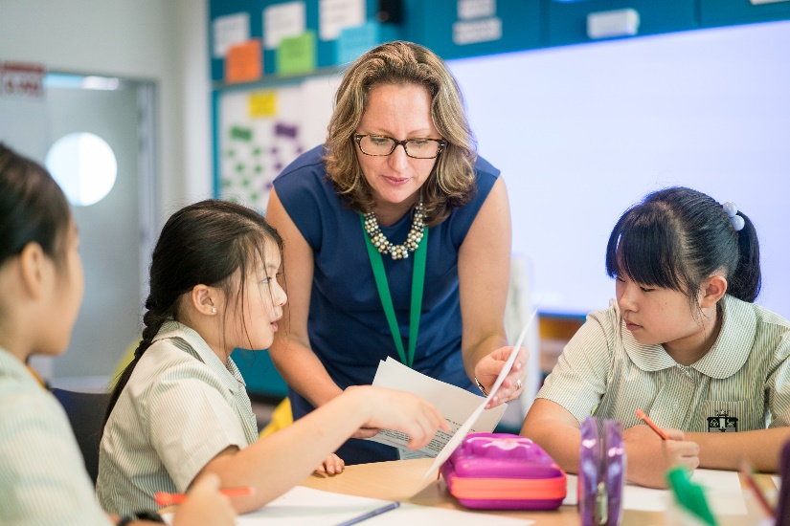
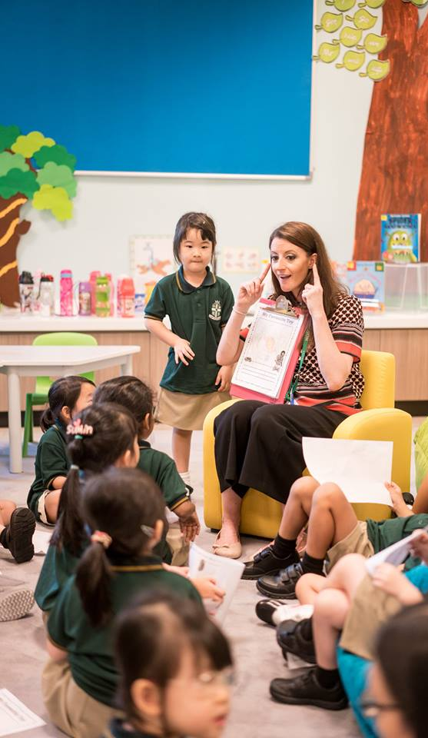
Enabling youth to learn how to learn,
and to learn how to live, empowering
them to become people of integrity
and people for others.

Slide 4


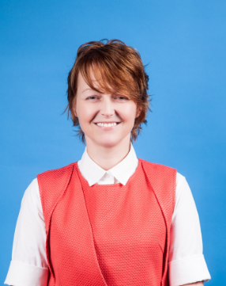
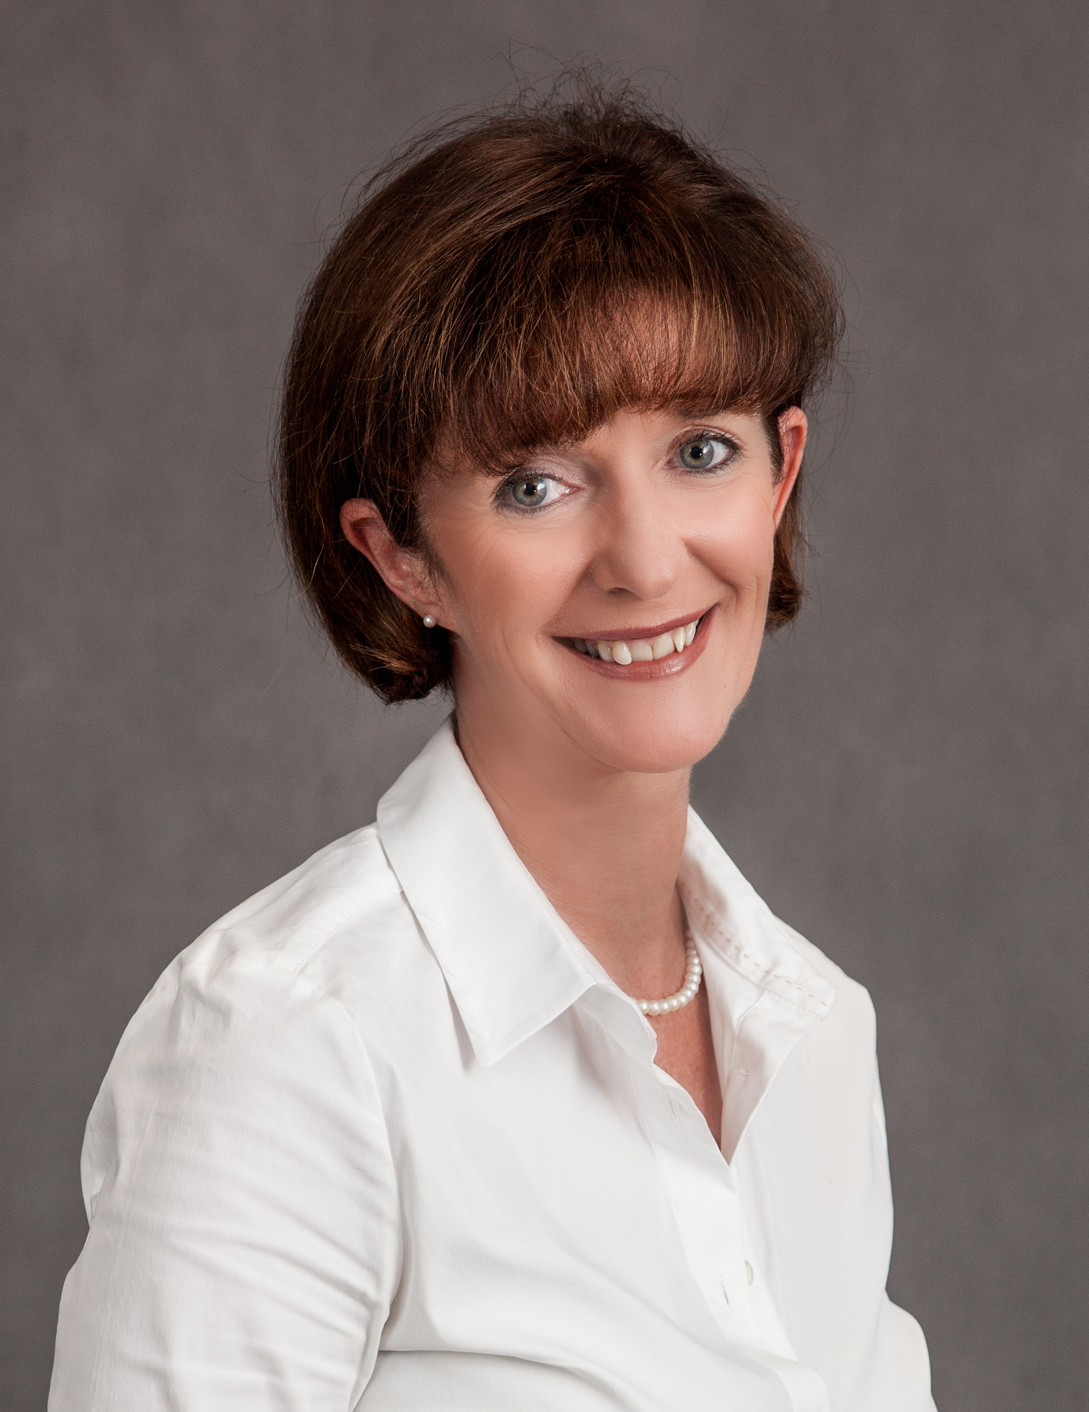
Welcome from the Principals
Thank you for showing interest in joining us at St Joseph’s Institution International (SJII) Malaysia. We hope this booklet provides you with some insight into our school, vision and procedures.
On August 29th 2016 SJIIM successfully opened the doors to 420 students from Nursery to Year 12. It has been wonderful to see the school coming alive to the sound of students and teachers. SJII Malaysia, a school of the De La Salle Brothers is a state-of- the-art building which offers a range of excellent facilities and resources that include, a soccer pitch, 25m swimming pool and training pool, roof-top tennis courts, basketball court, auditorium and two stunning libraries. Of course, the success of an outstanding school will be dependent on outstanding teachers who are committed to delivering the very best holistic Lasallian education to our diverse international learners.
Teachers joining SJII Malaysia will have a fantastic opportunity to join this ambitious new international school. They will be expected to seize the opportunity of working for a school which draws on 330 years of Lasallian educational tradition. They will benefit from well-resourced classrooms, low student ratios, brand new facilities and a range of opportunities for further professional development. They will also be able to draw upon the support network of our sister Lasallian schools in Singapore. We believe that SJII Malaysia offers a marvelous opportunity for teachers to enhance their professional skills and develop their careers.
We are seeking teachers who will motivate and inspire our pupils. They will deliver a stimulating and enriching International Curriculum that will equip our students to become compassionate, caring and successful global citizens. Teachers will be committed to holistic education, have high expectations, be skilled practitioners and outstanding role models. Teachers will engage in professional development and have an understanding of how to improve learning by applying cutting edge research.
Our school is situated in the rapidly developing area of Petaling Jaya, an attractive suburb of Kuala Lumpur. New shopping malls, railway links to the centre of KL, high quality residential accommodation, and excellent sporting facilities make this area highly desirable. Our school will be a focal point of this community.
The target enrolment is 1554 pupils, from Nursery to year 13. The school will be language rich where English is the language of instruction and Mandarin will be taught to an exceptionally high standard. The school has been awarded the candidacy to be an International Baccalaureate school for Years 12 and 13, and the IGCSE will be taught in years 10 and 11. The Elementary School will offer a dynamic and creative curriculum delivered through the International Primary Curriculum. Singapore Maths will form the basis of the mathematics programme. There will be a very strong extra-curricular offer, including languages, cultural activities, outdoor education, and sports, with particular emphasis on community service.
Please find further information on SJII Malaysia in this booklet. If you have a spirit of adventure, high professional standards and believe you can contribute to the development of our school we will look forward to reading your application.

Slide 5
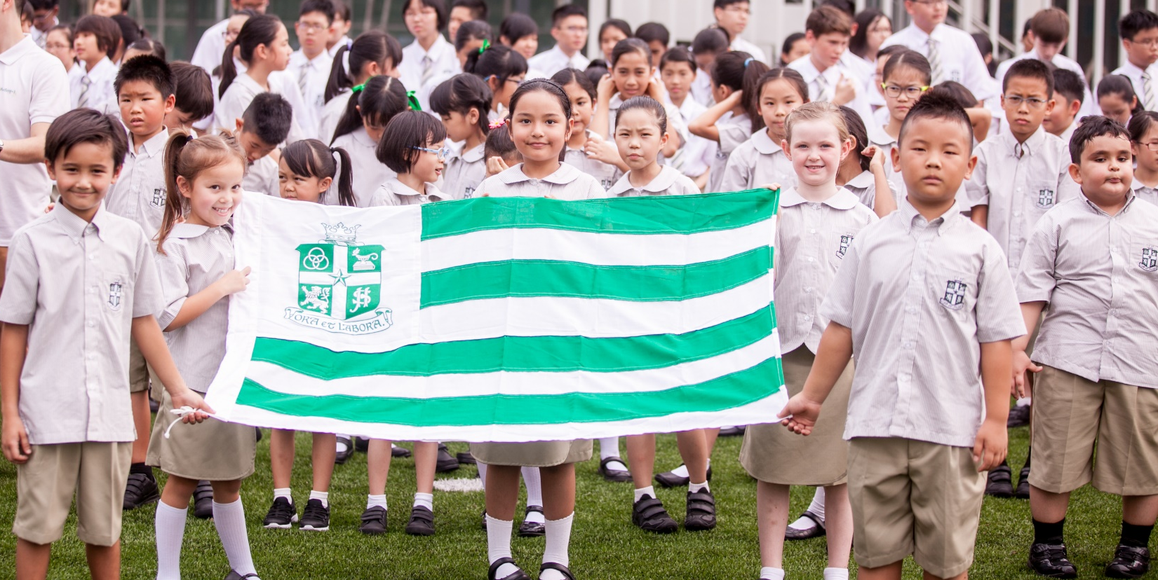


To be an international school of choice, recognised for values
centered education and learning driven by passion that nurtures
persons who make a difference to society.
We are committed to developing our students to become thinking
and caring global citizens who are at the same time securely rooted
in their community, share common values and have genuine
spiritual awareness.
Lifelong Learners who are resilient, creative, problem solvers,
adaptable and risk takers.
Equipped with life skills which will ensure they are respectful,
thoughtful, caring and compassionate.
Internationally Minded, they will have a sense of community and
engagement; celebrate diversity; take positive action and have global
awareness.

Slide 6
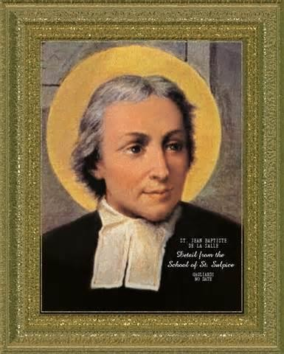


Although SJII Malaysia is a new school we
are associated with two schools in
Singapore: St Joseph’s Institution, with its
160 years of tradition in education and
its distinguished alumni, and SJI
International Singapore; one of the
highest achieving international schools in
Singapore. We will also be drawing on
the best practice from leading
international schools around the
world.
Underpinning all that what we do is the
ethos of the 330-year Catholic
educational tradition of the De La Salle
Brothers – named after St. John Baptist
de La Salle, the Patron Saint of
Teachers -- with its network of over 900
Lasallian educational institutions in 80
countries, including 67 universities.
Concern for the poor and social justice
Faith in the presence of God
Respect for all persons
Quality Education
Inclusive community

Slide 7


The Academic Leadership team consists of The Brother President, Brother
Thomas Lavin, The Elementary School Principal, Eileen Quigley and the High
School Principal, Stuart Glascott.
The Elementary School Principal oversees the Early Years, (Nursery and
Reception) and Years 1-6. The High School Principal will oversee Years 7-13.
The Nursery and Reception classes will follow the English Early Years
Curriculum Foundation Stage Curriculum.
Students in Y1-6 will follow two main programmes: The International Primary
Curriculum (IPC) and Singapore Math. The IPC will introduce a
comprehensive range of subjects in line with the English National Curriculum.
There will be a creative, progressive and thematic approach which will
enhance the total development of each student, cognitively, emotionally,
socially, physically and spiritually. Specialist teachers will be employed for
Physical Education, Art, Music, ICT, Chinese and Bahasa Malaysia.
Students in Years 7-9 will follow the National Curriculum of England and
Wales in preparation for the ICGSE (Years 10-11). Students in Year 12 and 13
will undertake the International Baccalaureate Diploma and have access to a
spacious IB lounge to assist them to develop independent study habits.
International
Primary
Curriculum
Singapore Math
Languages
Foundation
International
General
Certificate of
Secondary
Education IGCSE
International
General
Certificate of
Secondary
Information
International
Baccalaureate
Diploma
programme
(IBDP)
Early Years
Foundation
Curriculum
Based on the
English National
Curriculum
Based on the
English national
curriculum
Based on the
English national
curriculum
Cambridge
International
Examinations
Full IB Diploma
/ IB Courses

Slide 8
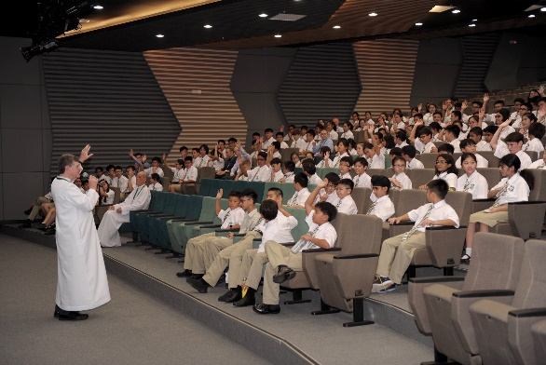
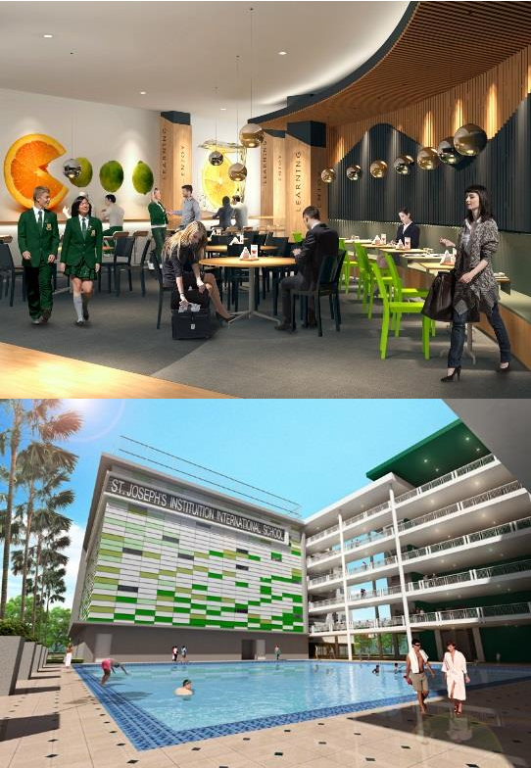
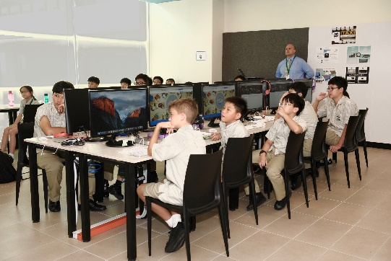
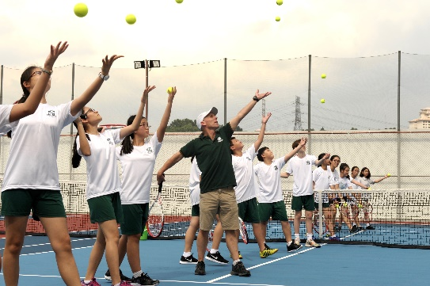
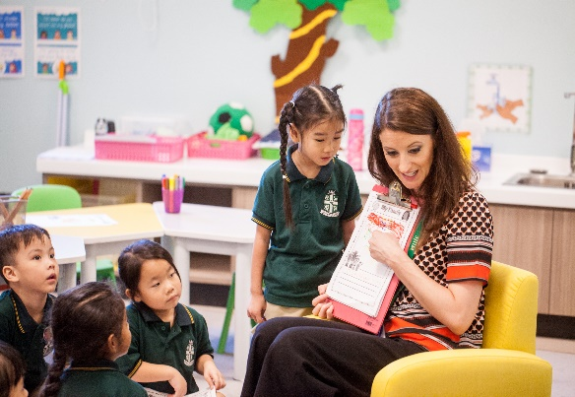
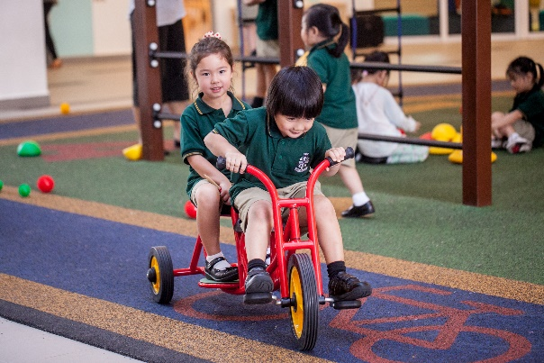
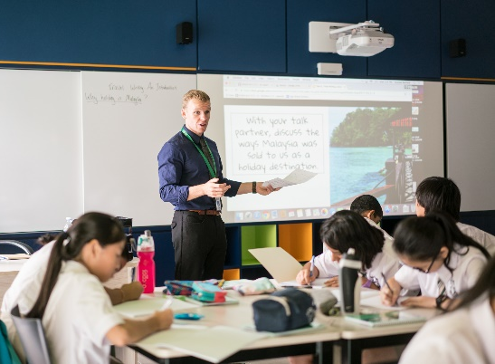
The Nursery and Reception classes will benefit
from a discreet area with its own outdoor
space, library, drama and music room. The
environment will cater for the 6 areas of
development as outlined in the English Early
Years Curriculum.
- Personal, social and emotional development
- Communication, language and literacy
- Creative development
- Physical development
- Knowledge and understanding of the world
- Problem solving, reasoning and numeracy
Pupils benefit from an inspiring and exciting
learning environment. Learning hubs have
been created in line with cutting edge practice
from around the world. State of the art
furniture, flexible learning spaces and creative
educational design will allow children to
develop independent learning skills and
learning attitudes and behaviours for the
future. Pupils will be organised into
registration groups of a maximum of 22 in the
Elementary School and 25 in the High School.
In the Elementary School each class will have a
class teacher and a learning support assistant.

Slide 9
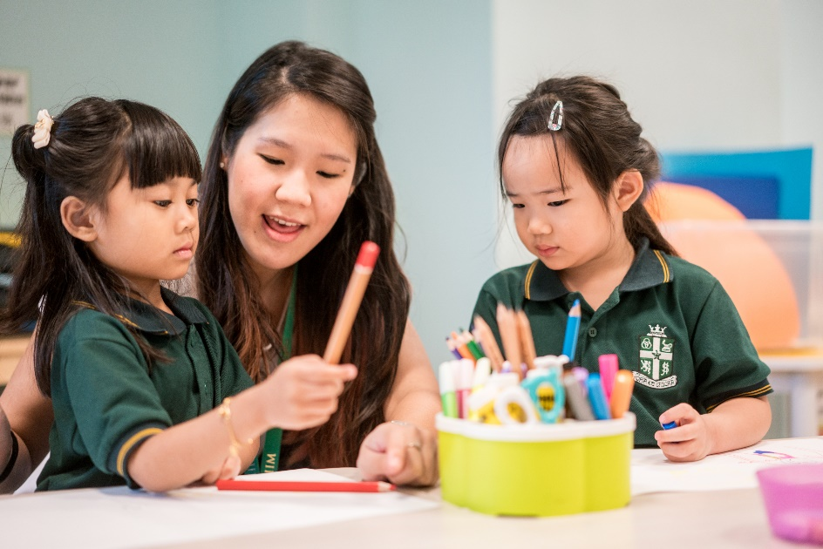
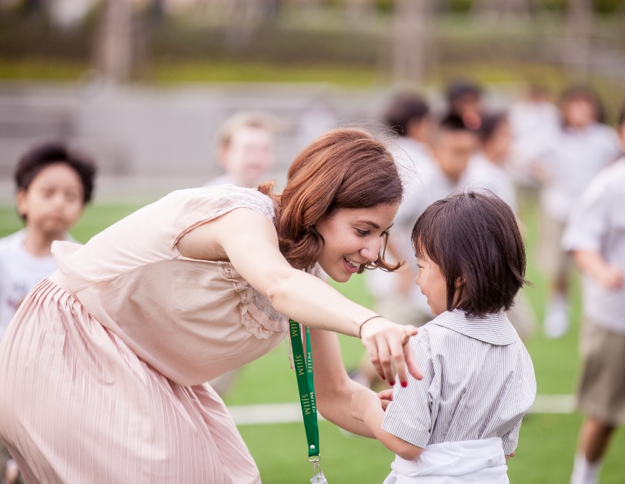

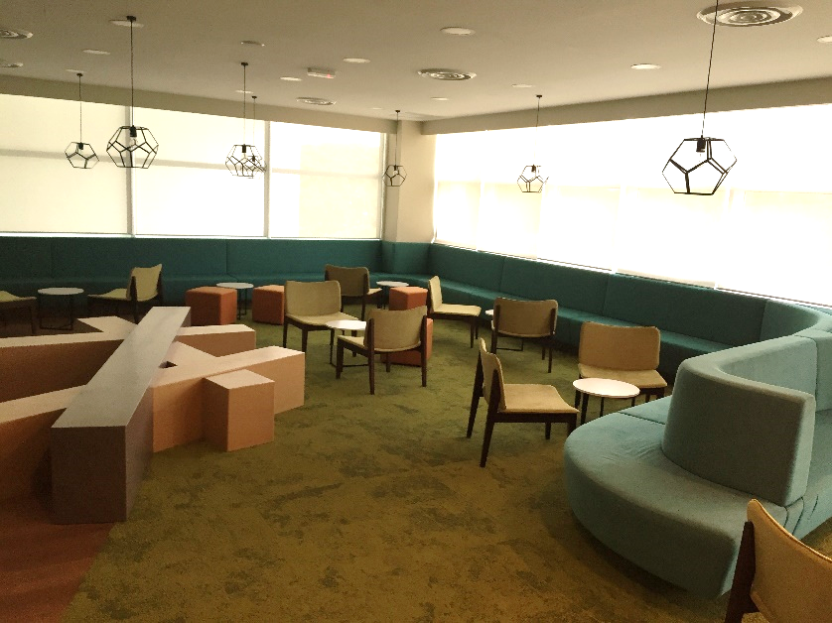
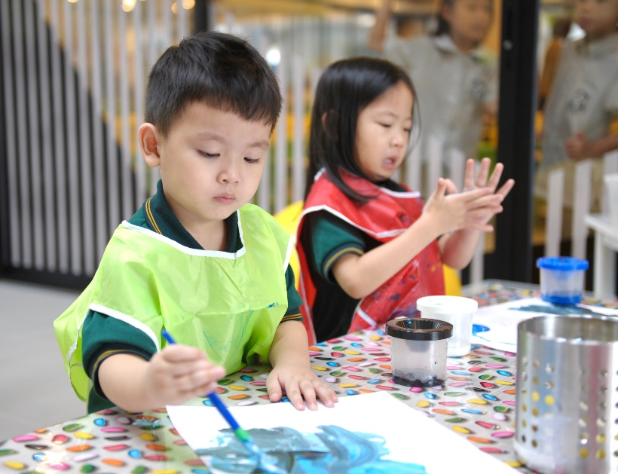
A well-considered and operational pastoral care system will be a key component of our School. Values will permeate the total climate of the relationships within it and staff in SJII Malaysia will be expected to treat students with respect, celebrate their differences and individuality and take pride in their success.
This will enable students to develop self-worth and skills to be independent, responsible and active and contributing members of their school and community. All staff in the school are expected to contribute to the pastoral care of students.

Slide 10


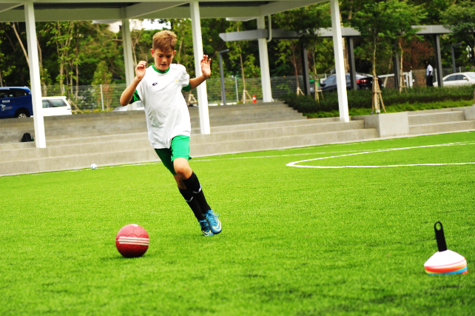
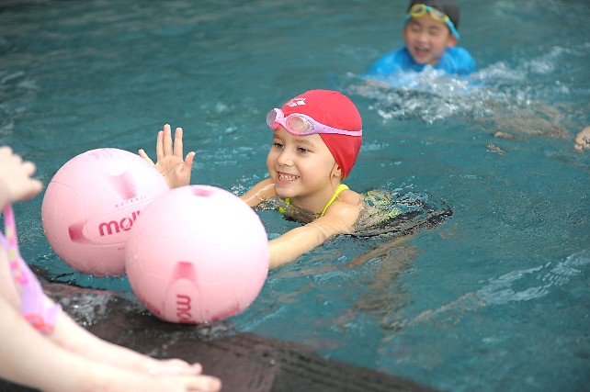
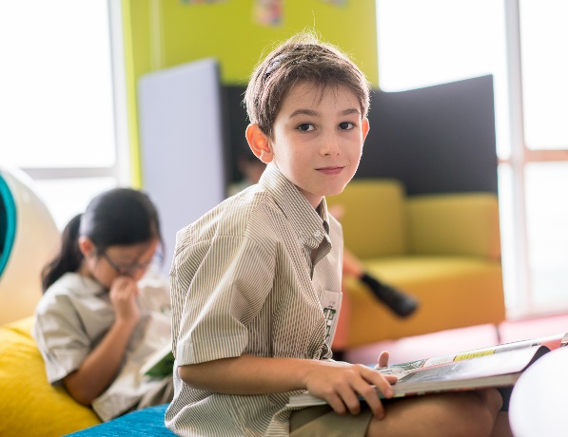
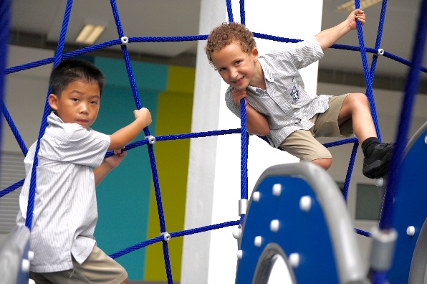
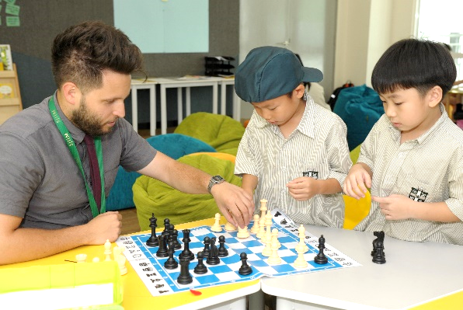
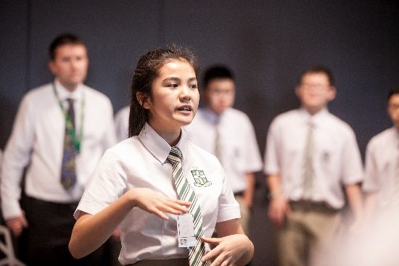
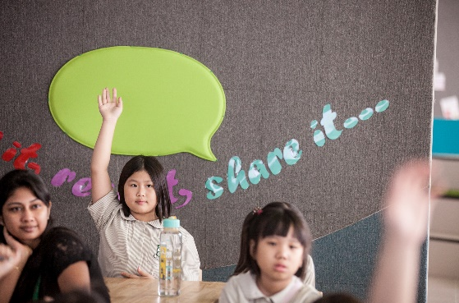
Our impressive facilities will be in use well beyond the school day. An extensive co-curricular program will be offered to students.
Sport, outdoor education, music, drama, debating and other artistic, creative and imaginative pursuits allow students to gain a sense of social and individual identity as well as a means of communication and expression. Co-curricular activities also provide the opportunity to nurture leadership skills as well as the ability to contribute in a team environment.
Performing Arts at SJII Malaysia provides students opportunities to express themselves creatively outside of the classroom environment, giving them rewarding, enriching and memorable experiences.
Sport will play a significant part in the life of the school and students will have the opportunity to develop self-confidence,
discipline, and fellowship in a range of House and interschool events.
Active participation is strongly encouraged for all students with an emphasis on ‘having fun’ whilst at the same
time developing skills, fitness and teamwork.
SJII Malaysia will prepare its students for life beyond the school
by developing students that have a positive attitude towards learning, can think critically and creatively and the ability to be
independent ‘lifelong learners’.
Leadership programs with an emphasis on community service and support, where students are empowered with the confidence to achieve’ will be a core component of the school.

Slide 11

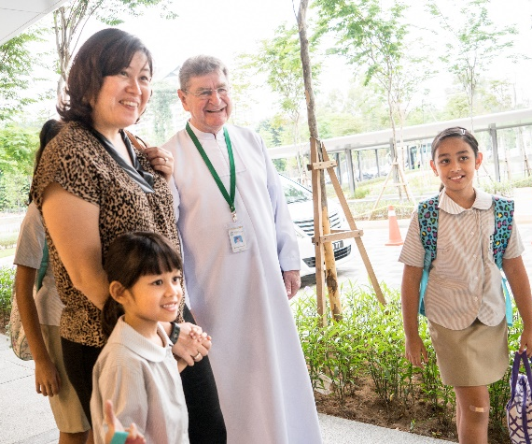
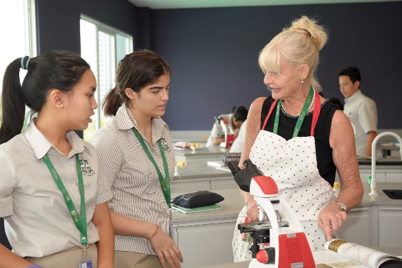


Through real life experiences, SJII Malaysia will provide
students with a better sense of today’s world and an
understanding of how to contribute in
inclusive and tolerant global society.
a compassionate,
In line with the Lasallian Core
Values of ‘Service to Others’
and ‘Community Building
from Within’, all students will
be involved in service
activities throughout their
time at SJII Malaysia. Service
activities will provide
students the opportunity to
serve their school and
Malaysian and international
communities in need.
Service activities at SJII Malaysia will not only involve
students doing things FOR others but also doing things
WITH others and therefore build leadership, collaboration
and communication skills.

Slide 12

If you have a spirit of adventure, high professional
standards and believe you can contribute to the
development of our school, please complete the
application form at this link. We will also need a
letter of application (maximum 2 pages) as well as a complete curriculum vitae.
Once completed, send the above to joinus@sji-
international.edu.my.
Please indicate clearly which post you are applying
for in the subject portion of the email.
Interviews sessions will take place in Kuala Lumpur,
London, Melbourne and via Skype.

Slide 13

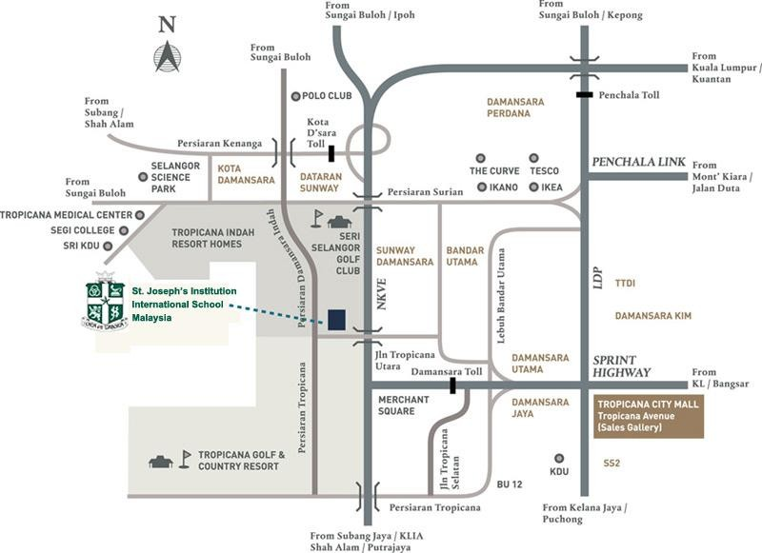
School Address:
St Joseph’s Institution International School Malaysia (PJ Tropicana Campus)
No.1, Jalan PJU 3/13,
47410 Petaling Jaya,
Selangor Darul Ehsan,
Malaysia.

Slide 14

School Address
St Joseph’s Institution International School Malaysia (PJ Tropicana Campus)
No.1, Jalan PJU 3/13,
47100 Petaling Jaya,
Selangor Darul Ehsan,
Malaysia.
Telephone
(603) 8605 3605
Email
Brother President: brothomaslavin@sji-international.edu.my
High School Principal: nbrown@sji-international.edu.my
Elementary Principal: eileenquigley@sji-international.edu.my
Marketing Enquiries: kenneoh@sji-international.edu.my
Admission Enquiries: enquiries@sji-international.edu.my
Website
www.sji-international.edu.my
Facebook
www.facebook.com/SJIIM

