Slide 1

The Ellen Wilkinson School
For Girls
Learning Support Assistant
RECRUITMENT INFORMATION
A Specialist College for
Science & Mathematics

Slide 2


Slide 3







Background
T
he Ellen Wilkinson School for Girls aims to represent excellence, independence and empowerment in the education of women. The school is fortunate to employ over 200 staff, educate over
development between the moment they arrive at the school and the time they leave. Of course, our very top students perform exceptionally well and advance on to top universities across the country.
The Ellen Wilkinson girl, by the end of her time at the school, will have achieved outstanding personal success and have developed a genuine love of learning. She will continue her pursuit of education and excellence and will, above all else, leave confident and prepared to play a vital role in society – It is this anchor which underpins all of the work we do individually and collectively as a staff.
1,400 girls, and boast a 5,000m² site.
We are proud to provide a curriculum that is not only challenging and engaging to our students, but also creates the best opportunity for every woman in the school to become independent and confident to face the challenges of a complex and challenging world.
Our curriculum is developed with the interest of every
student at it’s core, with the primary purpose of ensuring they leave with the life skills to reach their potential and lead fulfilling lives. The rich curriculum we offer allows our students to thrive equally in academic and creative disciplines. This is complimented with an extensive range of extra curricular activities which are designed to enhance the students’ experience at every level.
We are united with our stakeholders by a strong sense of community and service, for the purpose of ensuring that all of our students make exceptional progress in their own unique ways. We are consistently amongst the top schools for value added; that is to say our students
demonstrate amongst the highest rates of growth and
Top 25% IN UK

Slide 4

The Role
Learning Support Assistant
Post Title: Learning Support Assistant
Report to: Under the direction of Special Educational Needs Co-ordinator (SENCO)
Salary: NJC Scale Point 3 (approximately £14,500 per annum Inclusive of allowances pro rata)
Hours: 5 days per week (32.5 hours per week), term time only, 39 weeks per year (195 days)
The post has a probationary period of six months.
Main Purpose of the Post
To support the learning needs and/or physical needs of identified pupils, in the context of the school community, class, small groups and on school visits.
To work with and supervise individuals and groups of children under the direction/instruction of teaching and/or senior staff, inclusive of specific individual learning needs. This support will enable access to learning for all pupils.
Duties and Responsibilities
Establish effective working relationships with pupils, acting as a role model and setting high expectations.
Provide consistent support to all pupils, responding appropriately to individual pupil needs.
Promote inclusion and acceptance of all pupils.
Encourage pupils to interact with others and engage in activities led by the teacher.
Promote self-esteem and independence, employing strategies to recognise and reward achievement within established school procedure.
Provide feedback to pupils in relation to progress and achievement under the guidance and direction of the teacher.
Use specialist skills/training/experience to support pupils.

Slide 5
The Role
Learning Support Assistant
Provide clerical/administration support (e.g. SEND administration, maintain up-to-date student record files)
Establish and maintain an appropriate learning environment under the supervision of the teacher.
Contribute to lesson planning, evaluating and adjusting lessons/work plans as appropriate.
Monitor and evaluate pupils’ responses to learning activities through observation and planned recording of achievement against pre-determined learning objectives.
Provide objective and accurate feedback and reports as required to the teacher on pupil achievement, progress and other matters, ensuring the availability of appropriate evidence.
Be responsible for keeping and updating records, contributing to reviews of systems/records as requested.
Administer and assess routine tests and accurately record achievement/progress.
Promote positive values, attitudes and good pupil behaviour and encourage pupils to take responsibility for their own behaviour in line with whole school policies
Liaise sensitively and effectively with parents/carers as agreed with the teacher within your role/responsibility and participate in feedback sessions/meetings with parents under teacher’s supervision.
Work with individual pupils or groups of pupils using prepared resources including the use of software packages designed to support pupils’ learning.
Read and scribe for pupils with SEND as directed by the SENCO
Support teaching staff in preparing internal examinations
Escort pupils with physical or mobility needs around the school site as directed by the SENCO
Support for the Curriculum
Support the delivery of agreed learning activities/learning programmes, adjusting activities according to pupil learning styles and individual needs.
Support the delivery of literacy/numeracy programmes, effectively utilising all alternative learning opportunities to support extended development.
Support the use of ICT in learning activities and develop pupils’ competence and independence in its use.
Assist pupils to access learning activities through specialist support, e.g. curriculum/SEND specialism.
Determine the need for, prepare and maintain general and specialist equipment and resources.

Slide 6
The Role
Learning Support Assistant
Support for the School
Be aware of and comply with school policies and procedures relating to child protection, health, safety and security, confidentiality and data protection. Report all concerns to the appropriate person (as named in the policy concerned).
Be aware of and support difference and ensure all pupils have equal access to opportunities to learn and develop.
Contribute to the school ethos, aims and development/improvement plan.
Establish constructive relationships and communicate with other agencies/professionals, in liaison with the teacher, to support achievement and progress of pupils.
Attend and participate in regular meetings as appropriate.
Participate in training and other learning activities as required.
Establish own best practice and use to support others.
Assist in the supervision, training and development of classroom support staff.
Assist with the planning of opportunities for pupils to learn in out-of-school contexts, according to school policies and procedures and within working hours.
Accompany teaching staff and pupils on visits, trips and out of school activities as required.
The post holder may reasonably be expected to undertake other duties commensurate with the level of responsibility that may be allocated from time to time.
This is a Job Description only and is not necessarily a comprehensive definition of the post. It sets out the duties of the post at the time it was drawn up and should be seen as describing in more detail aspects of the duties set out in the Education Act (School Teachers’ Pay and Conditions of Employment) Order 1987 Schedule 3.
The Head of the School may vary the duties from time to time without changing their general character or the level of responsibility entailed. Any modification or amendment will be made after consultation with the holder of the post.
Our school is committed to safeguarding and promoting the welfare of the children and expects all staff to share this commitment

Slide 7

The Person Specification
Essential Requirements
Knowledge, Skills, Abilities
Ability to work in collaboration with others, as a member of a team both within the classroom and as part of the whole school team.
Ability to supervise and support pupils of all ages with a wide range of physical/learning needs.
To communicate effectively both verbally and in writing, with colleagues, parents/carers and other agencies in order to carry out the tasks as directed by the teacher.
Willingness to learn how to set up and use resources and equipment, e.g. low vision and hearing aids, audio visual equipment and information technology.
To be numerate and literate in order to carry out the written and numeric aspects of the posts, both with regards to the curriculum and other tasks as directed by the teacher.
To be aware of the need for confidentiality concerning issues linked to home/pupil/teacher and school and to keep confidences appropriately.
Ability, with training, to develop skills to meet the needs of pupils with a wide range of behaviour in various settings.
Ability to make assessments by observing children and feed these back to the teacher.
Ability to work without close supervision.
Ability to be sensitive and efficient when carrying out duties in connection with pupil illness and accidents and other individual needs.
Education and Experience
Education to at least GCSE level (or equivalent) in Maths and English.
Experience of working with children and young people in a voluntary or work capacity.
Personal Qualities
Ability to demonstrate an excellent record of punctuality and attendance.
Have an enthusiastic and positive attitude towards learning and a belief that all children can succeed..
Have confidence in supporting students’ learning up to at least the standards expected at GCSE level.
A willingness to learn about a range of physical disabilities and ways of supporting such pupils.

Slide 8
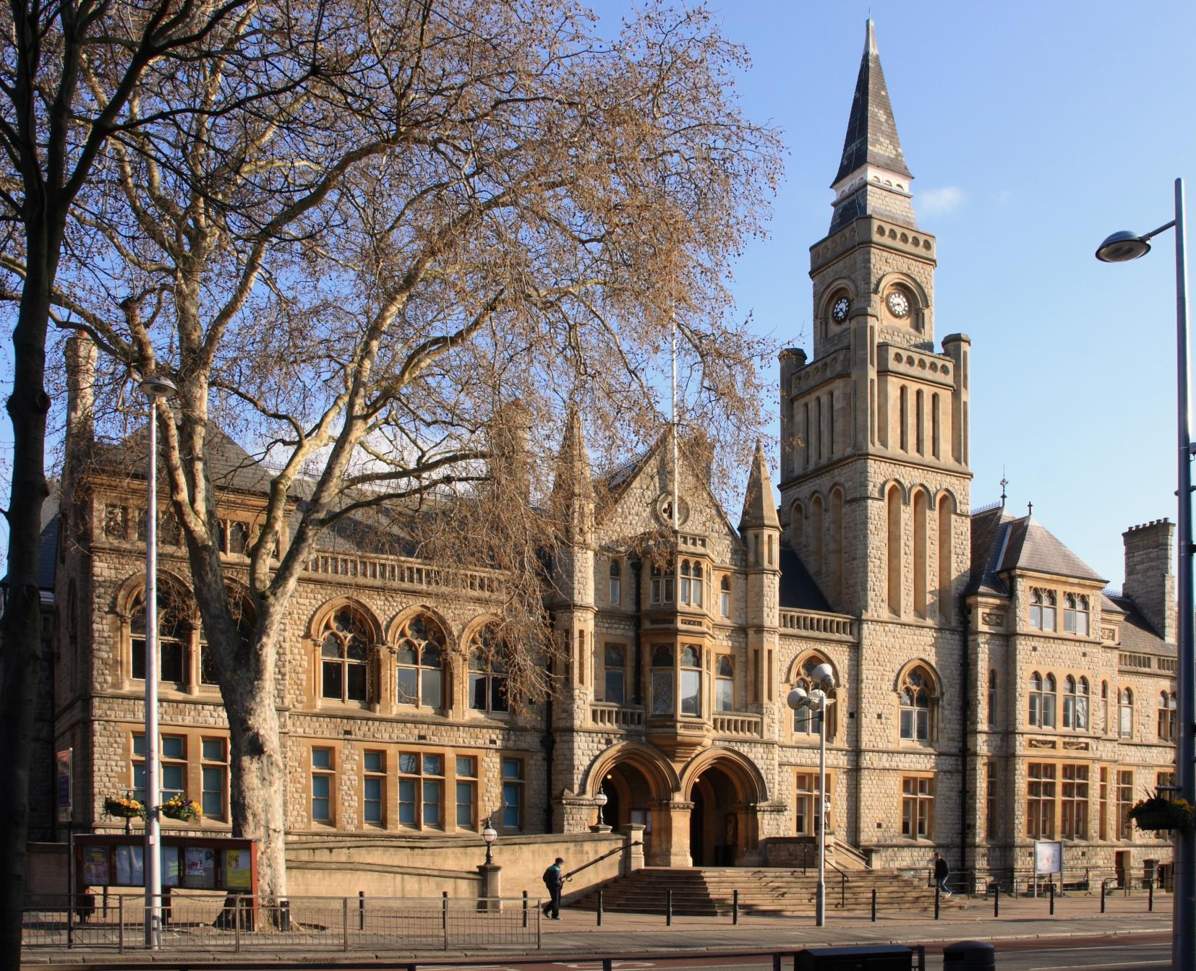
Living and working in Ealing
T
ransport
Tube: The school is a very short walking distance from West Acton Station (Central Line Zone 3) and North Ealing Station (Piccadilly Line Zone 3), offering
C
ulture and Amenities
Popular restaurants and bars include The Grapevine, The Grange, and Charlotte’s Place, historically winning the Good Food Guide Readers’ London Restaurant of the Year.
very short travel times to and from the West End and Westfield Shopping Centre.
Rail: First Great Western trains from Ealing Broadway and West Ealing to Paddington take just 10 to 15 minutes, with the Heathrow Connect service getting you to the airport in less than 30 minutes.
Bus: Ealing is served by an impressive number of bus routes, including the 65 (to Kingston), 83 (to Golders Green) and 297 (to Willesden).
Cycle: Proposals to build a Cycle Superhighway between Tower Hill and Acton could make life even easier for Ealing cyclists, who currently enjoy a 40 minute cycle to Hammersmith.
The borough enjoys its very own Blues, Jazz, Comedy and Beer festivals throughout the year.
Savvy shoppers in the area go to Ealing Broadway Shopping Centre which has most high street chains and just a little further away, to Westfield Shopping Centre.
The Pitshanger Bookshop is an Ealing institution and the independent store has been helping locals pick out their next must read for almost 20 years.
Ealing continues to prove itself as a perfect mix of green suburban charm and urban convenience and accessibility.

Slide 9

How to apply
T
he Ellen Wilkinson School for Girls seeks to appoint a Learning Support Assistant to contribute towards the vision and effectiveness of a dedicated and successful school.
Applications should be submitted to the office, via email, in the post or in person at:
HR Administrator
The Ellen Wilkinson School for Girls
Queens Drive
West Acton
London
W3 0HW
office@ellenwilkinson.ealing.sch.uk
www.ellenwilkinson.ealing.sch.uk/1321/vacancies
Closing date for applications is on Tuesday 20th February 2018 at 12 noon. We will contact shortlisted applicants only.
The school is committed to safeguarding and promoting the welfare of children and young people and expects all staff and volunteers to share this commitment.
Successful applicants will be subject to an enhanced DBS check and medical questionnaire.

Slide 10
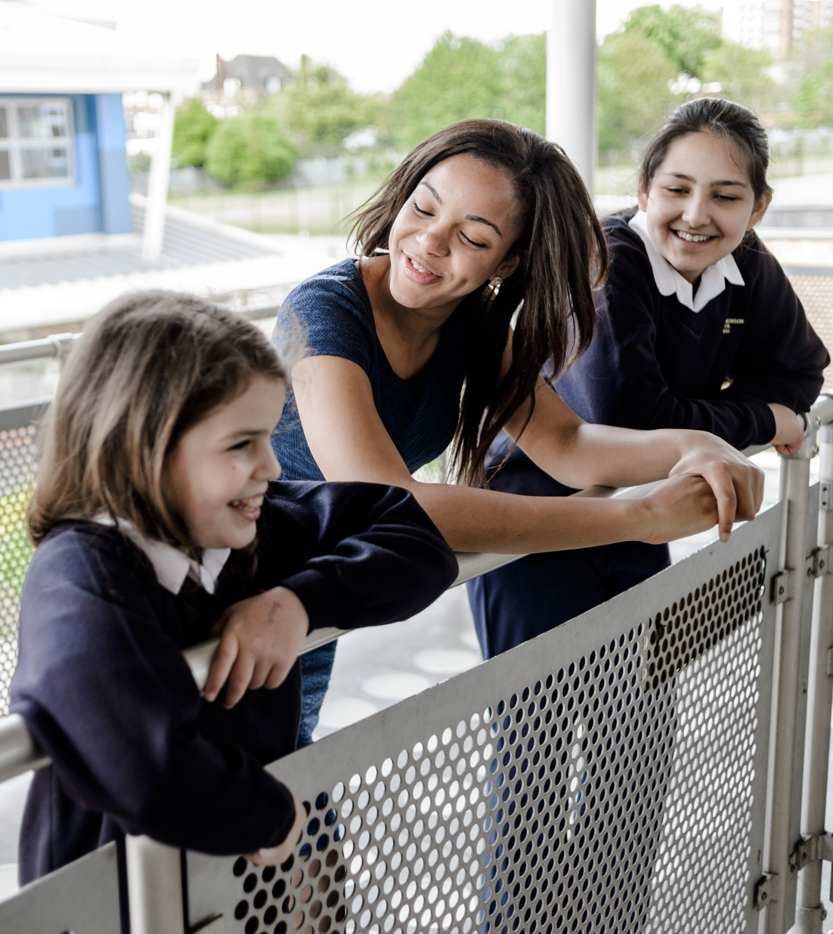

Slide 11
The Ellen Wilkinson School
For Girls
Queens Drive, London W3 0HW
0208 752 1525 | www.ellenwilkinson.ealing.sch.uk

Slide 12
The Ellen Wilkinson School
For Girls
Inspiring
Passionate
Nurturing
Successful
Creative
A Specialist College for
Science and Mathematics
The Ellen Wilkinson School for Girls is a high achieving, creative and vibrant school superbly located in the heart of Ealing, where girls receive the encouragement and support to become successful, determined and confident young women.
This year, the school achieved outstanding GCSE results including a
Progress 8 of +0.86 (Top in the Borough)
Learning Support Assistant
5 days per week (32.5 hours per week), term time only (39 weeks per year)
Salary: NJC Scale 3 (approx £14,500 per annum inclusive of allowances pro rata)
This post has a probationary period of six months
An exciting opportunity has arisen for a Learning Support Assistant within our school. We are looking for a well-qualified, motivated and experienced individual to take on this rewarding and fulfilling role.
We would like to hear from you if you have recent experience working within a Secondary school setting. You will need to have the skills to meet the range of needs of our SEN pupils and ensure that your input makes a difference to their confidence, progress and achievement in school.
You must be a pleasant and willing individual with the ability to remain calm and cheerful under pressure.
Closing Date for the post is Tuesday 20th February 2018 at 12 noon.
Recruitment Pack and Application Forms can be obtained from
www.ellenwilkinson.ealing.sch.uk/1321/vacancies
or by contacting +44 (0)208 752 1525

