Slide 1

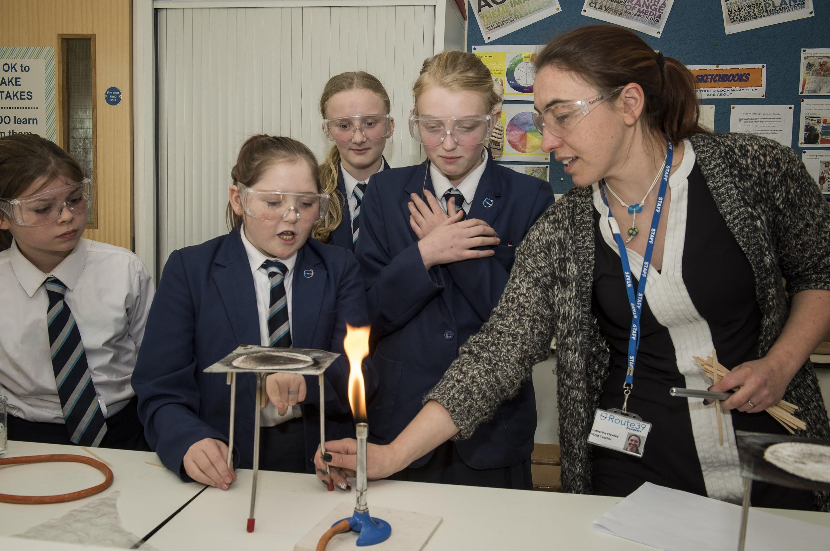
Teacher of Science
Candidate Pack

Slide 2
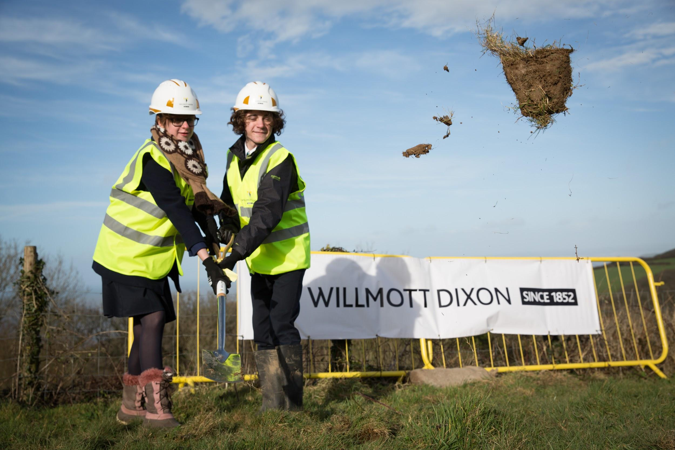

Slide 3
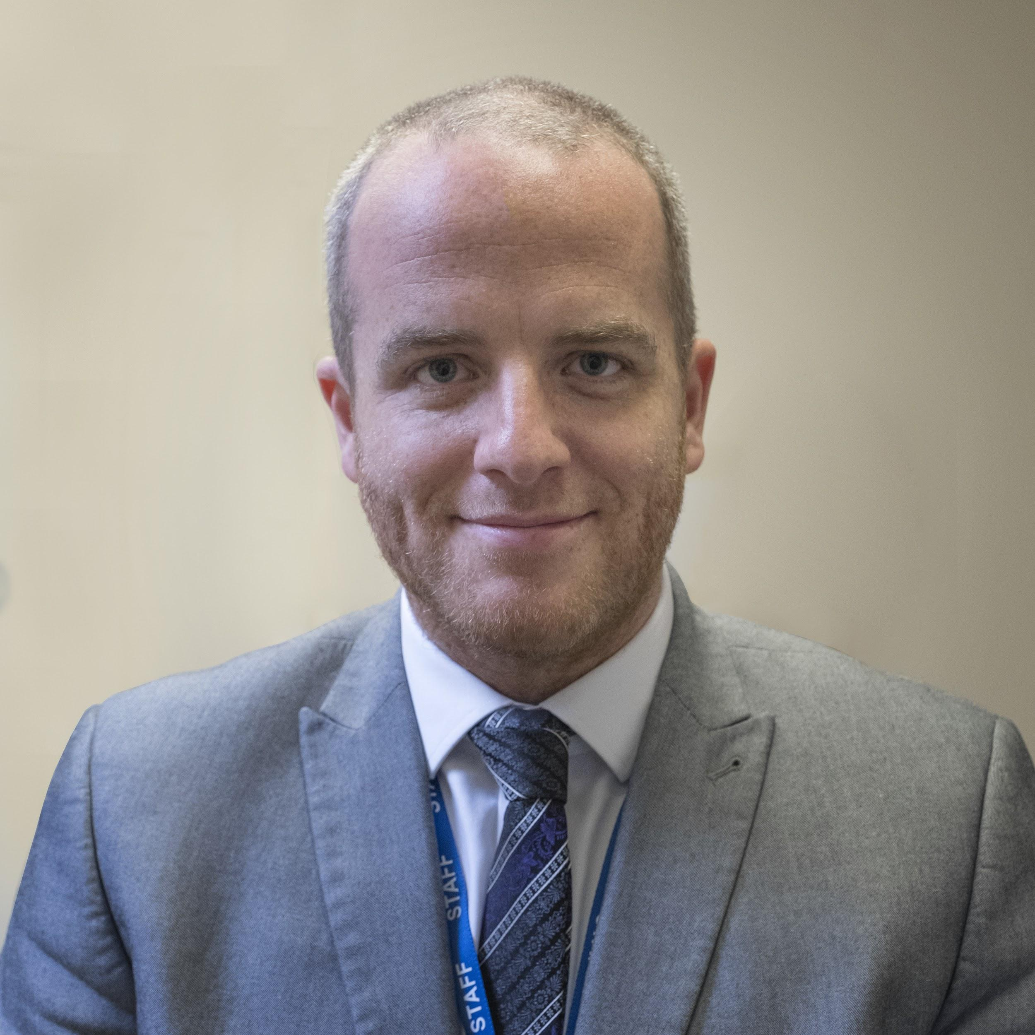
Dear Colleague,
Do you want to be part of something exceptional?
Thank you for your interest in joining the team at Route 39
Academy. Before you go further I will warn you that this will not
be easy but I also promise that it will be fun! We are a group
driven by our passion for learning and a commitment to each
and every individual in our community.
I firmly believe that the time has come for education in this country to move forward into the 21st century. At Route 39 Academy we are designing a school from scratch; this is a unique opportunity to really make a difference. I am looking for colleagues to join our existing team who share the same vision and values and will work hard to make our Academy the very best it can be.
As a member of the team you will help develop the learning approach and the curriculum that will bring alive our ethos of Engage – Respect – Aspire and set the standard for years to come. We aspire to be a school that others look to for inspiration.
I look forward to receiving your application.
Regards
David Ray, Acting Principal

Slide 4
The Advertisement
Key information
Applications are invited from Teachers of Science
Closing date for applications: Noon, Monday 5th February
Salary: in line with national pay scales
Location: Clovelly, north Devon
Contract type: Negotiable
Contract term: Permanent
Contract starts: 16th April 2018
Interviews: Thursday 7th February
Route 39 Academy
Do you have the ability to think outside the box? Do you welcome challenge and innovation? Would you like to join a small, dynamic team of committed teachers and help to shape a growing school? We are looking for colleagues with a track record of achievement who are able to contribute to all aspects of Academy life. Applicants should be able to demonstrate inspirational teaching and be committed to achieving outstanding outcomes for all students.
Route 39 Academy is an 11-18 state ‘free’ school that opened in September 2013. We are in our fifth year and currently have 155 students aged 11-16. We are a new choice for North Devon and take a 21st century approach to learning. We are building a brand new school in Bucks Cross, opening in summer 2018, which will enable us to expand to 700 students, and incorporate a sixth form.
We are seeking to appoint passionate and engaging teachers who are not constrained by the traditional approach to secondary education. People who see connected learning and strong relationships as the key to success and have high aspirations for the young people they work with.
Route 39 Academy has a specialism of personalisation with an extended school day. Science is a core part of both the curriculum and the extended opportunities that our longer school day allows. Science is delivered through Project Based Learning for all students who have their own personal Google Chromebooks. We are currently delivering Science GCSE with our first students sitting in Summer 2018. There will be opportunities to deliver further science based courses at both KS3 and KS4 for the successful applicant. We want our students to make the most of the local environment and see the classroom extending beyond the four walls of the school.

Slide 5
Route 39 Academy is a Free School with its own terms and conditions. Staff are valued and given time during the week for collaboration and their own learning and progression.
North Devon is well-known for its rugged coastline, stunning views and Area of Outstanding Natural Beauty. Its numerous beaches and surrounding countryside offer perfect opportunities for relaxation and tranquillity, as well as active pursuits such as hiking, cycling, surfing and diving. The area consists of small rural villages, with neighbouring small market and coastal towns. Local employment is mainly in tourism and farming, but there is increasing diversification as more young families move into the area. There is a range of thriving primary schools, and a strong and vibrant local community.
As an equal opportunities employer we are committed to safeguarding and promoting the welfare of children and young people. We expect all staff to share this commitment. An enhanced DBS check, proof of qualifications and a medical check will be required of the successful applicant. We aim to attract the best educators to The Route 39 Academy and are committed to support the continuing development of their skills.
For more information, please visit our website: www.route39.org.uk
How to Apply
To apply, candidates should submit the following:
A TES Application Form, which must be completed in full. We cannot accept CVs.
A Personal Statement of no more than two sides of A4.
If you require any assistance, please contact Michelle Carter, Principal’s PA, as below. For more information about this position or to arrange an informal discussion about your application with the Principal, please contact Michelle Carter (email michelle.carter@route39.org.uk or phone: 01237 431 969).
Please note we will request references for candidates selected to attend interviews within two days of drawing up the final list.
Completed application forms and personal statements should be emailed to michelle.carter@route39.org.uk.

Slide 6
Job Description
Job Title
Teacher of Science
Reports to
Leader of Science
Job Purpose
To contribute to the development of a strong, effective academy with an emphasis on promoting a culture of educational excellence, within a caring and secure environment enriched with the values of engage, respect, aspire which extends beyond the academy into the wider community.
To develop, maintain and enhance a curriculum which, at all phases, offers relevant, challenging and extended opportunities for academic and personal development helping to ensure that all students and staff achieve their personal best and that students maintain progress into the next phase of their learning.
Teaching and Learning
Teach Science within the Route 39 Academy Curriculum Guidelines
To deliver excellent lessons week in, week out
To peer coach others to deliver excellent lessons week in, and week out
To provide on-going, specific and personal feedback to students on a regular basis
To observe outstanding peers in order to improve your practice
To have an ‘open door’ policy so colleagues can observe your lessons
To have the skill and flexibility to deliver excellent lessons in new ways, in new settings and with new curriculum content
To plan for outstanding lessons across a scheme of work, a term, a year and across different ages
To understand progression and be able to assess against benchmarks
To be skilled at using data to plan learning and interventions for individual students
Maintain resources to the required safety standards and renew, as necessary within the budgetary allowance

Slide 7
Curriculum
To develop a curriculum where students are excited and see the relevance and connections of their learning
To use debate and enquiry to further student understanding
To set up the systems, routines and high standards of a new curriculum
Develop and implement a strategy for teaching the curriculum
To use data to intervene where there is underachievement
To develop high quality schemes of work and lesson plans
To enrich the curriculum with outside visits, speakers and events
A new pedagogy
To plan and deliver inter-disciplinary projects which bring together knowledge and skills, are focused on real-world enquiries and which culminate in a high quality end product
To be interested in new ways of delivering our curriculum in the community, in the countryside, in different learning spaces
To organise trips and exchanges to further children’s understanding
To contribute to and run extended curriculum opportunities
To ensure that learning habits underpin each and every learning experience
To be innovative at using new technology to enhance learning
To support student study (independent and collaborative)
Learning and collaborating
To be a creative and deep thinker about pedagogy
To work with colleagues to plan the whole academy’s curriculum
To reflect constantly on what and how children learn
To work with colleagues to address particular learning challenges
To be immersed both in your subject specialism and the literature around how children learn
To be interested in cutting edge techniques and research
To ensure effective communication with parents so that they can support the academy and their child

Slide 8
Leading Teaching and Learning
To be accountable for student performance
To employ effective monitoring and tracking systems to ensure all children are making progress
To monitor the effectiveness of learning and teaching
To devise exciting learning led projects with other staff
To keep up-to-date with the latest developments in education and research
To build partnerships with outside organisations
To ensure other subjects are integrated into rich learning experiences
Team-working and collaboration
Participate in any relevant meetings and professional development opportunities that relate to the learners, curriculum or organisation of the academy, including pastoral arrangements and assemblies
Work as a team member and identify opportunities for working with colleagues and sharing the development of effective practice with them
Contribute to the professional development of other teachers and support staff, including the induction and assessment of new teachers and teachers serving induction periods
Take part as required in the review, development and management of the extended curriculum
To attend team meetings and contribute to the strategic direction of the academy
Cover for absent colleagues as required by the Principal
Other Professional Requirements
To carry out other reasonable tasks from time to time as directed by the Principal
This job description is likely to evolve over time following consultation between the job holder and the Principal. It forms part of the contract of employment for the person appointed to the post.
Organisation Chart
Principal
|
Senior Leadership Team
| | |
Teaching Staff Teaching Assistants Administrative and
(inc. Cover Technical Staff
Supervisors)

Slide 9
Essential
Desirable
Qualified Teacher Status
Degree qualification in your teaching specialism
An excellent teacher, achieving the ‘Teachers’ Standards’
Evidence of taking responsibility for own professional development
Evidence of outstanding teaching skills - having an impact on students’ learning, raising achievement and adding value
Teaching to GCSE and A Level
Knowledge of current developments in teaching and learning
Evidence of working with other professionals as part of a team
Evidence of recent and relevant continuing professional development and study
Evidence of teaching a second subject
Experience of using ICT in innovative ways
Experience of personal involvement in extra-curricular activities
Experience and knowledge of TLO Learning Habits
Experience and knowledge of restorative approaches
Experience and knowledge of coaching
Experience of teaching literacy
Person Specification
How assessed: personal statement; assessed tasks; interview; references
Knowledge, Experience and Training

Slide 10
Essential
Desirable
Ability to identify and develop inspirational learning experiences
Ability to make informed use of assessment to differentiate learning
Ability to use ICT effectively to support and enhance learning
Ability to use information and data to raise achievement
Ability to identify and implement effective strategies for intervention
Resilient
Enjoys a challenge
Sees opportunities rather than difficulties
Ability to drive a minibus
An understanding of Human Scale Education, its principles and ethos
Ability to lead INSET sessions
Ability to anticipate problems and identify opportunities
Person Specification continued
How assessed: personal statement; assessed tasks; interview; references
Professional and Personal Qualities

