Slide 1


JOB APPLICATION PACK
Success Academy Trust

Slide 2
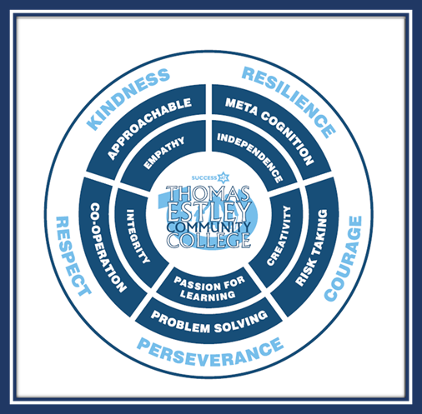
Community of Courage & Commitment to Success
Aiming to achieve our best.
Taking full advantage of every learning opportunity.
Showing resilience through our experiences and challenges.
Seeking out our talents and following our dreams.
Reaching out for opportunities to lead and encourage others.
Making a positive difference and celebrating success.
Including the whole community, sharing, caring and giving time as needed.
Treating each other with kindness, fairness and respect.
Finding space in our lives for fun, joy, praise and laughter.

Slide 3

Station Road, Broughton Astley, Leicestershire, LE9 6PT Tel: 01455 283 263
admin@thomasestley.org.uk - www.thomasestley.org.uk
Dear Applicant, February 2025
Pre-School Practitioner
Term time only – Permanent
Commencing immediately
Thomas Estley Community College is a popular college serving the village of Broughton Astley, Cosby and surrounding areas. We have a current number on roll of over 900 Key Stage 3 & 4 students, as well as a specialist communication and interaction provision, and host a satellite base of Birkett House Special School. We are the lead school in Thomas Estley Learning Alliance (an alliance of over twenty primary and secondary schools) and the secondary school in Success Academy Trust. The College also has extensive extended schools provision including our primary out of school club, Pre-School, Sea Cadets and secondary extra-curricular clubs, as well as adult and community evening provision.
We have a strong family ethos and are looking for an enthusiastic and committed applicant who wants to work with our warm, welcoming team to further our mission statement of Building Leadership and Character Together. Should you decide to apply for this role, please ensure that you use the Personnel Specification for guidance when completing your application form.
Pre-school
Our registered Pre-School runs sessions for children aged 2-5 years working within Early years foundation stage (EYFS). The Pre-school accepts 3 &4 year old (and some 2 year olds dependant on circumstances) funded and non-funded places.
The ideal candidate will have some experience working with children aged under the age of 5, be flexible, have knowledge of good practise in the care and education of Pre-school children and hold a relevant qualification.
Registered in England – Company No: 8135389 VAT Reg: 153227431
College Principal: Mandi Collins - College Manager: R.Wheller

Slide 4
Station Road, Broughton Astley, Leicestershire, LE9 6PT Tel: 01455 283 263
admin@thomasestley.org.uk - www.thomasestley.org.uk
Working as a member of the team/ flexibility in availability to cover other sessions and assisting in administration and organisation as required. Ensuring the Children Act and Ofsted requirements are complied with by operating within the group's policy framework, particularly in relation to health and safety, child protection and equal opportunities.
Liaison with parents/carers and other staff to ensure children are welcomed and supported, alongside participation in appropriate professional staff development and training including annual personal & professional review
It is vital to the ethos of the Support Team that the post holder is flexible in taking on additional tasks, willing to offer help and to cover for other member of the Team when required and treats co-operation and support for colleagues as a top priority.
All of our work is firmly based within our values, collaboratively agreed and committed to by all of our stakeholders.
Aiming to achieve our best.
Taking full advantage of every learning opportunity.
Showing resilience through our experiences and challenges.
Seeking out our talents and following our dreams.
Reaching out for opportunities to lead and encourage others.
Making a positive difference and celebrating success.
Including the whole community, sharing, caring and giving time as needed.
Treating each other with kindness, fairness and respect.
Finding space in our lives for fun, joy, praise and laughter.
Application forms can be found on our website www.thomasestley.org.uk.
We look forward to receiving your application via email to hr@thomasestley.org.uk.
Please note the closing date for applications is Monday 24th February 2025 at 9am
Yours Faithfully
Mandi Collins
Principal
Registered in England – Company No: 8135389 VAT Reg: 153227431
College Principal: Mandi Collins - College Manager: R.Wheller

Slide 5

Featuring additional entitlement to our
‘Three Steps to Success’ for all our
Success Academy Trust staff...
ENTITLEMENT TO OUR TRUST TRAINING PACKAGE AS APPROPIATE TO CAREER STAGE DEVELOPMENT, ROLE AND EXPERIENCE
TALENT MANAGEMENT DEVELOPMENT ROUTES WITHIN THE TRUST WITH A PERSONALISED CEREER PLAN
WELLBEING FOR SUCCESS – OUR OWN PERSONAL WELLBEING AND SUPPORT PACKAGE TO HELP YOU FLOURISH
Please visit Success Academy Trust to view 'Who we are'

Slide 6
Job Title: Pre-School Practitioner
Grade: 5 point 7 currently £24,408 FTE (actual £14,114.95)
Hours: 25 per week
Responsible to: Pre-school Lead for day-to-day management / direction
Key relationships with: College Principal, College Manager, other Nursery / Pre-school Assistants, College Support Staff and other members of the Senior Management Team, Teaching Staff, Premises Officers, College Members, pupils, parents, local community
Job purpose:
To assist in the provision of the care, safety and learning of the children.
WHOLE COLLEGE RESPONSIBILITIES:
Support current policies and recognised good practice within the college
Be aware of the importance of confidentiality and data protection
Participate in annual Performance Reviews with your Line Manager, based on agreed objectives.
Willingness to be flexible in both approach and use of time.
All tasks should be undertaken with due regard to Health & Safety regulations.
To undertake such other duties which are within the scope of the job purpose, title of the job and its grade.

Slide 7
THOMAS ESTLEY COMMUNITY COLLEGE -
PERSONNEL SPECIFICATION
Job Title: Pre-school practitioner
Scale: 5 point 7
QUALIFICATIONS & TRAINING
EXPERIENCE
SKILLS/ ATTRIBUTES
GENERAL CIRCUMSTANCES
ESSENTIAL
NVQ 3 qualification or equivalent.
Experience of working with children under five in informal or formal settings
Knowledge of good practice in under fives care and education
Personal organisation.
Good communication skills.
Good team worker.
Willingness to undertake staff development and training.
An understanding of, and commitment to, Equal Opportunities, and the ability to apply this to strategic work and day-to-day situations
Must be eligible to work in the UK
DESIRABLE
Knowledge of requirements of the Children Act.
Knowledge of Ofsted requirements.

Slide 8
MAIN DUTIES & RESPONSIBILITIES:
Children's Care
Ensuring the well-being, safety and security of the children
Helping in setting up and clearing away
Supervision of children, including toilet trips (mopping up if necessary)
Children of staff are treated in the same way as all children in the session, this may mean other staff correcting your child (if applicable)
Maintaining records as directed
Children's Learning
Assisting in the planning and implementing a multi-cultural play curriculum to stimulate children's interest in learning
Assisting in the monitoring of the quality of learning
Assisting in the monitoring and recording of children's development
Assisting in planning in relation to Ofsted Early Learning Goals (the Foundation Stage)
Management, Organisation and Administration
Working as a member of the team/ flexibility in availability to cover other sessions
Assisting in administration and organisation as required including fee collection
Ensuring the Children Act and Ofsted requirements are complied with
Operating within the group's policy framework, particularly in relation to health and safety, child protection and equal opportunities
Liaison with parents/carers and other staff to ensure children are welcomed and supported
Participation in appropriate professional staff development and training including annual personal & professional review
To respect the confidential nature of personal information
To attend fire drills and staff meetings as required

Slide 9
All Thomas Estley Community College employees are expected to promote and safeguard the welfare of students at this school.
The job description sets out the responsibilities of the post at the time it was drawn up. Such responsibilities may vary from time to time without changing the general character and requirements of the post or the level of responsibility entailed.
Variations are a common occurrence and do not necessarily constitute additional responsibilities or warrant a higher grade.

