Slide 1

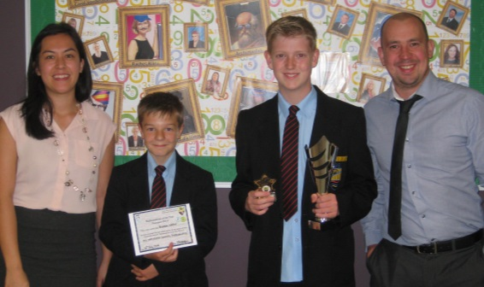
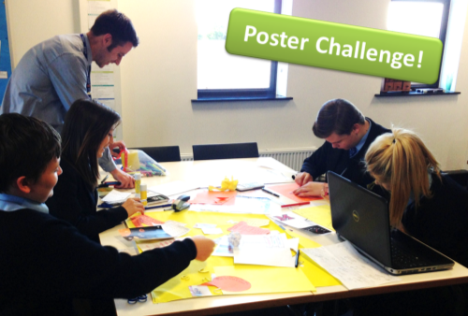
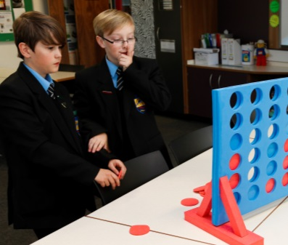
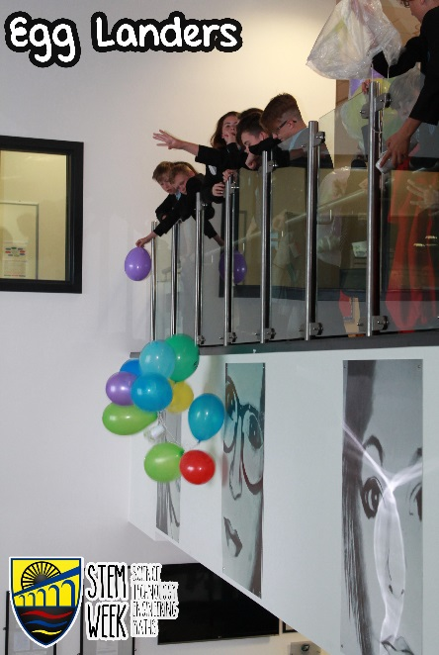
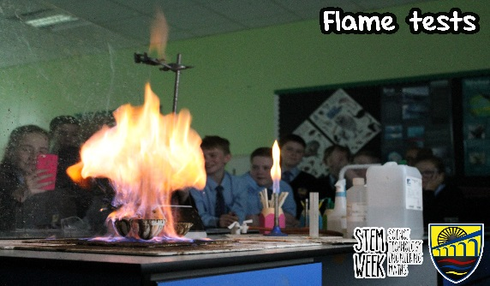
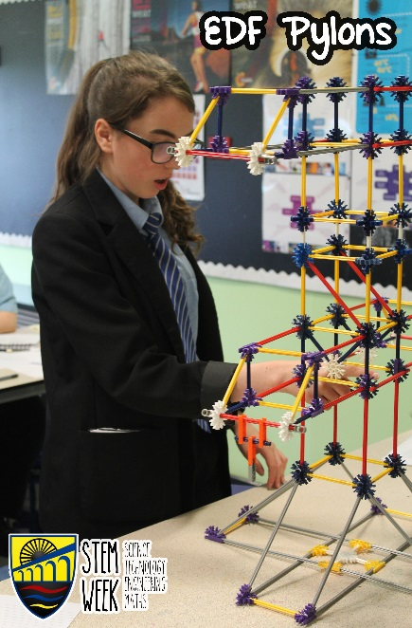
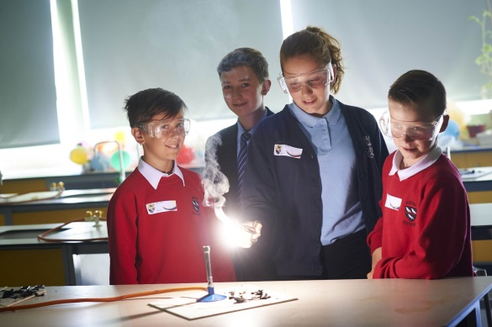
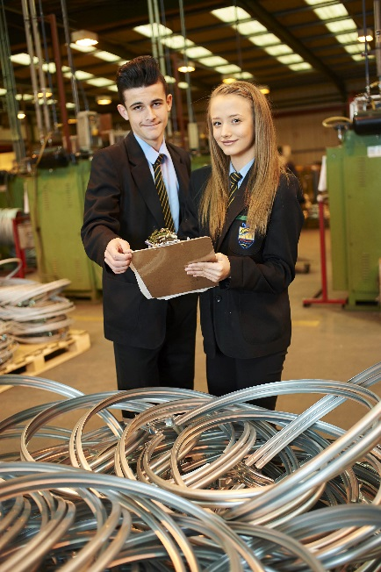
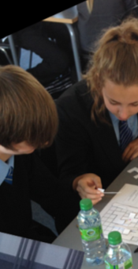
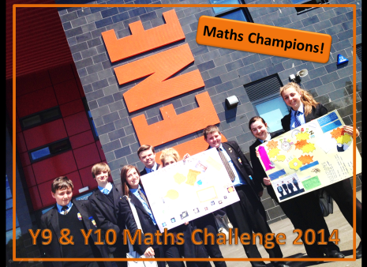
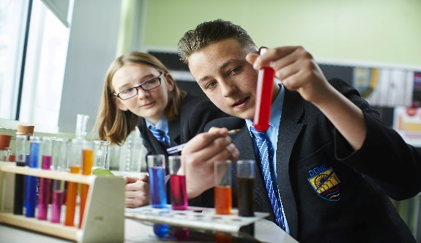
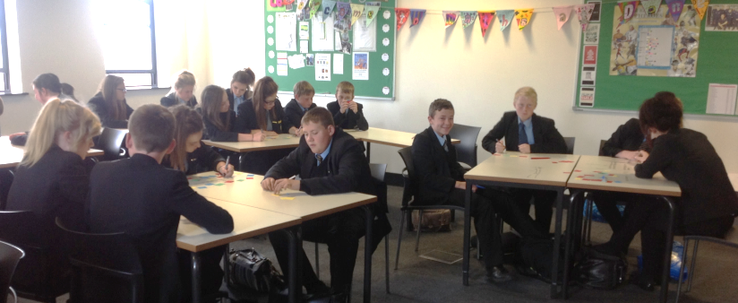
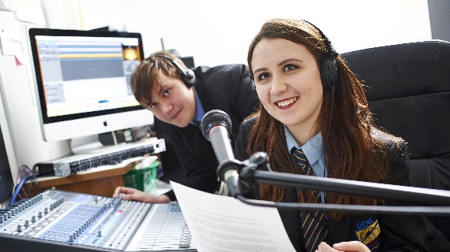

Dene Community School
Subject Leader of Science Application Pack
The Science Department at Dene are dedicated to delivering a supportive, exciting and engaging curriculum, which is designed to provide both challenge and support for all students. Our six fully fitted science labs enable us to develop the lab skills of our students and bring ‘working scientifically’ to the forefront of our day to day teaching. We aim for our students to feel part of a community, allowing them to grow in confidence and share a sense of pride in their achievements.
We are looking to appoint a dedicated, inspirational and outstanding teacher to undertake the role of Subject Leader. The successful candidate will share our community ethos and have an excellent knowledge of the curriculum.

Slide 2
Dene Community School
Contact Details
Mr D A Nelson
Head Teacher
Manor Way
Peterlee,
County Durham
SR8 5RL
Telephone: +44 (0) 191 5546000
Fax: +44 (0) 191 518 0119
email: enquiries@dene.durham.sch.uk
twitter: @DeneCST
Mr L Sowerby
Deputy Head Teacher
email: enquiries@dene.durham.sch.uk

