Slide 1

The Ellen Wilkinson School
For Girls
TEACHER OF SCIENCE
RECRUITMENT INFORMATION
A Specialist College for
Science & Mathematics

Slide 2


Slide 3







Background
T
he Ellen Wilkinson School for Girls aims to represent excellence, independence and empowerment in the education of women. The school is fortunate to employ over 200 staff, educate over
development between the moment they arrive at the school and the time they leave. Of course, our very top students perform exceptionally well and advance on to top universities across the country.
The Ellen Wilkinson girl, by the end of her time at the school, will have achieved outstanding personal success and have developed a genuine love of learning. She will continue her pursuit of education and excellence and will, above all else, leave confident and prepared to play a vital role in society – It is this anchor which underpins all of the work we do individually and collectively as a staff.
1,400 girls, and boast a 5,000m² site.
We are proud to provide a curriculum that is not only challenging and engaging to our students, but also creates the best opportunity for every woman in the school to become independent and confident to face the challenges of a complex and challenging world.
Our curriculum is developed with the interest of every
student at it’s core, with the primary purpose of ensuring they leave with the life skills to reach their potential and lead fulfilling lives. The rich curriculum we offer allows our students to thrive equally in academic and creative disciplines. This is complimented with an extensive range of extra curricular activities which are designed to enhance the students’ experience at every level.
We are united with our stakeholders by a strong sense of community and service, for the purpose of ensuring that all of our students make exceptional progress in their own unique ways. We are consistently amongst the top schools for value added; that is to say our students
demonstrate amongst the highest rates of growth and
Top 25% IN UK

Slide 4
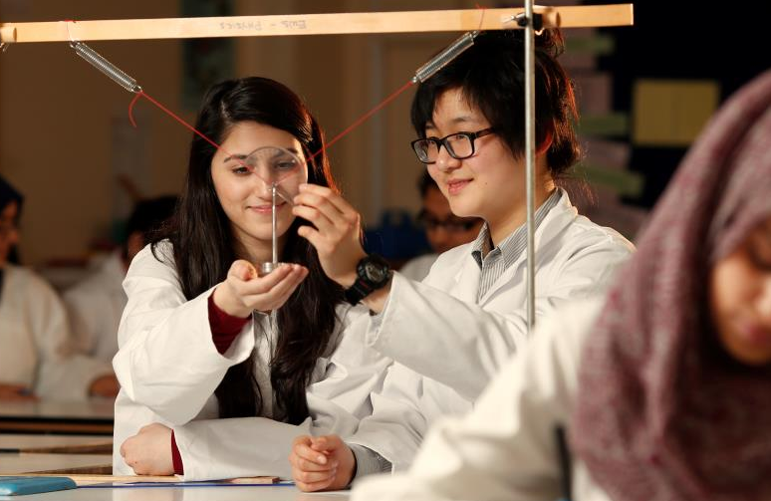
The Role
TEACHER OF SCIENCE
Post Title: Teacher of Science
Report to: Head of Department
Salary: EWS Teacher Pay Scale (MPS) (Possibility of TLR)
Supervisory Responsibility: The post holder may be responsible for the deployment and supervision of the work of Teaching Assistants relevant to their responsibilities.
Summary
To teach Science across the age and ability range of the school, and any subsidiary subject offered to an appropriate level.
Duties and Responsibilities
To carry out duties at all times with due regard to the principles of Equal Opportunities.
1. Teaching & Learning
To teach the classes and groups assigned with due regard to the National Curriculum, the Curriculum of the School and the Schemes of Work of the Department.
This includes planning and preparation of courses and lessons, setting of homework and marking of work carried out by pupils.
To continue the development, successful delivery and assessment of all courses which form a key part of the Department’s curriculum.
2. Achievements of Pupils
To promote the achievement of each individual pupil by setting appropriate goals, promoting high standards of achievement in work and behaviour.
To engender enthusiasm for pupil learning through purposeful work and good classroom control and organisation.

Slide 5
The Role
Teacher of Science
3. Assessment, Recording and Reporting
To enter fully into monitoring and assessment, recording and reporting procedures.
4. Review
To take part in the review, development and evaluation procedures relating to the Science Department.
5. Current Developments within Subjects
To keep abreast of current developments in Science, and any subsidiary subject as appropriate, with particular reference to National Curriculum criteria.
6. Record Keeping
To maintain accurate records relating to the schemes of work, lesson plans and other departmental matters.
7. Staff Development
To attend and participate in appropriate in-service courses deemed to be relevant both to the department and the School.
To take part in the school’s Performance Management process and procedures.
8. Pastoral
To play a full part in the pastoral functions of the school, usually as a form tutor. This includes involvement in the delivery of the Personal, Social and Health Education programme.
To provide relevant guidance to pupils on educational and social matters, and on further education and future careers.
9. Behaviour of Pupils
To maintain good order and sensible behaviour, and appropriate supervision of pupils.

Slide 6
The Role
Teacher of Science
10. Communication
To communicate and consult with parents of pupils, other professionals and members of the Governing Body, or appropriate.
11. Contribution to the Departmental and Year Teams
To contribute to the smooth running of the Department and the Pastoral Team by carrying out reasonable tasks.
12. Cross Curricular
To work in partnership with other subject departments to ensure the delivery of cross-curricular themes.
13. Extra Curricular
To take a full part in the extra curricular life of the school.
14. Health & Safety
To be pro-active in ensuring the school’s Health & Safety Policy is implemented. To safe guard the health and safety of pupils both when they are on school premises or when engaged in authorised school activities elsewhere.
15. Specific Points
Additional specific points to be agreed according to the responsibilities of the post.

Slide 7
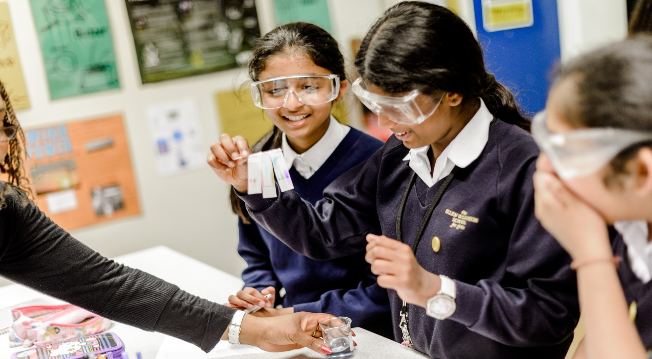
The Person Specification
Please make sure, when completing your application form, that you give clear examples of how you meet the criteria.
Essential Qualification Criteria
All applicants must:
Be deemed suitable to work with children
Be qualified to degree level or above
Be eligible to teach in the UK
Be eligible to the right to work in the UK
Have a good command of spoken and written Standard English.
Experience:
Teaching/training at secondary school level
Working/training in a multicultural environment
Knowledge:
3. Have in depth knowledge of main teaching subject
Have up-to-date knowledge of current educational developments in relation to that subject at whole school
level
5. Have awareness of current approaches and teaching strategies in main subject and any other subject offered
6. Be vigilant regarding Safeguarding
Skills:
Ability to engender enthusiasm for the teaching subject(s) and motivating pupils through setting purposeful
work
Ability to encourage learners to develop self-esteem. To keep themselves and others safe and to have
respect for others
Ability to plan and deliver high quality lessons, evaluate the impact of these and develop future planning
accordingly

Slide 8
The Person Specification
10. Ability to promote high standards of achievement in work and behaviour
11. Ability to teach across the whole ability and age range of the school
12. Show a clear grasp of Assessment, Recording and Reporting (including target setting)
13. Ability to use new technology to support both the curriculum and organisation
14. Ability to monitor and evaluate teaching and learning and act upon the outcomes, including data analysis
15. Ability to assess the needs of individuals to inform lesson planning
16. Ability to prioritise, pay meticulous attention to detail, work under pressure and meet strict deadlines
QUALITIES
17. To show willingness (and/ or experience of) to foster good relationships with all the school’s stakeholders
18. To demonstrate commitment to team work and collaboration, including assisting in
19. To be hardworking, determined and conscientious
To be a reflective practitioner, able to self-evaluate and develop professionally
This is a Job Description only and is not necessarily a comprehensive definition of the post. It sets out the duties of the post at the time it was drawn up and should be seen as describing in more detail aspects of the duties set out in the Education Act (School Teachers' Pay and Conditions of Employment) Order 1987 Schedule 3.
The Head of the School may vary the duties from time to time without changing their general character or the level of responsibility entailed. Any modification or amendment will be made after consultation with the holder of the post.

Slide 9
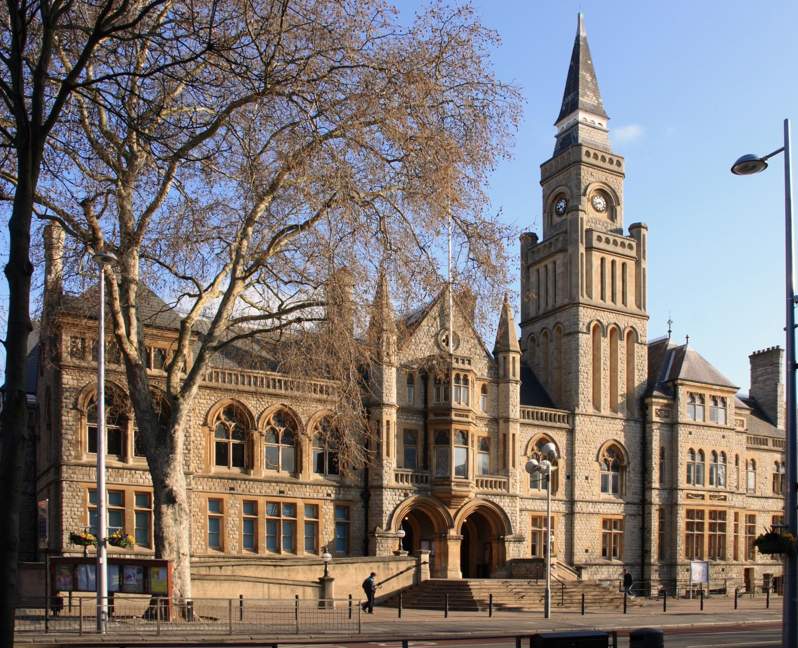
Living and working in Ealing
T
ransport
Tube: The school is a very short walking distance from West Acton Station (Central Line Zone 3) and North Ealing Station (Piccadilly Line Zone 3), offering
C
ulture and Amenities
Popular restaurants and bars include The Grapevine, The Grange, and Charlotte’s Place, historically winning the Good Food Guide Readers’ London Restaurant of the Year.
very short travel times to and from the West End and Westfield Shopping Centre.
Rail: First Great Western trains from Ealing Broadway and West Ealing to Paddington take just 10 to 15 minutes, with the Heathrow Connect service getting you to the airport in less than 30 minutes.
Bus: Ealing is served by an impressive number of bus routes, including the 65 (to Kingston), 83 (to Golders Green) and 297 (to Willesden).
Cycle: Proposals to build a Cycle Superhighway between Tower Hill and Acton could make life even easier for Ealing cyclists, who currently enjoy a 40 minute cycle to Hammersmith.
The borough enjoys its very own Blues, Jazz, Comedy and Beer festivals throughout the year.
Savvy shoppers in the area go to Ealing Broadway Shopping Centre which has most high street chains and just a little further away, to Westfield Shopping Centre.
The Pitshanger Bookshop is an Ealing institution and the independent store has been helping locals pick out their next must read for almost 20 years.
Ealing continues to prove itself as a perfect mix of green suburban charm and urban convenience and accessibility.

Slide 10
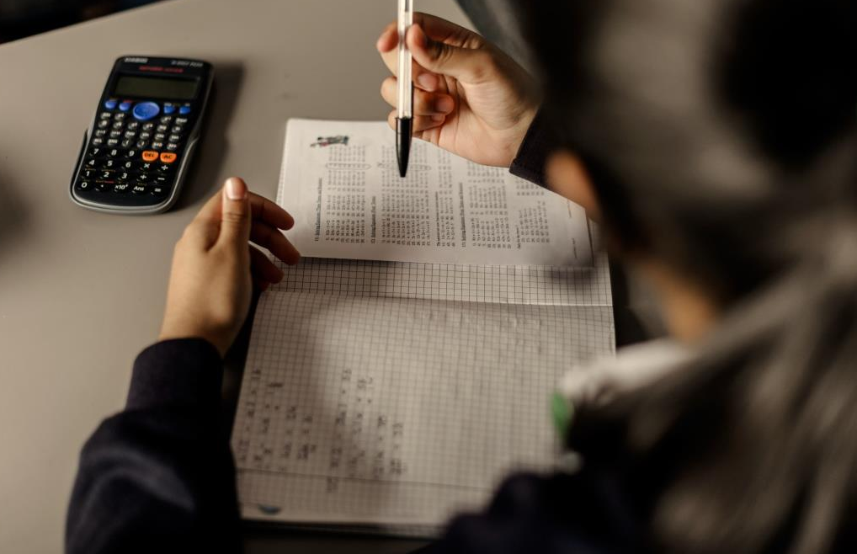
How to apply
T
he Ellen Wilkinson School for Girls seeks to appoint a Learning Support Assistant to contribute towards the vision and effectiveness of a dedicated and successful school.
Applications should be submitted to the office, via email, in the post or in person at:
HR Administrator
The Ellen Wilkinson School for Girls
Queens Drive
West Acton
London
W3 0HW
office@ellenwilkinson.ealing.sch.uk
www.ellenwilkinson.ealing.sch.uk/1321/vacancies
Closing date for applications is on Monday 19th February 2018 at 12 noon. We will contact shortlisted applicants only.
The school is committed to safeguarding and promoting the welfare of children and young people and expects all staff and volunteers to share this commitment.
Successful applicants will be subject to an enhanced DBS check and medical questionnaire.

Slide 11
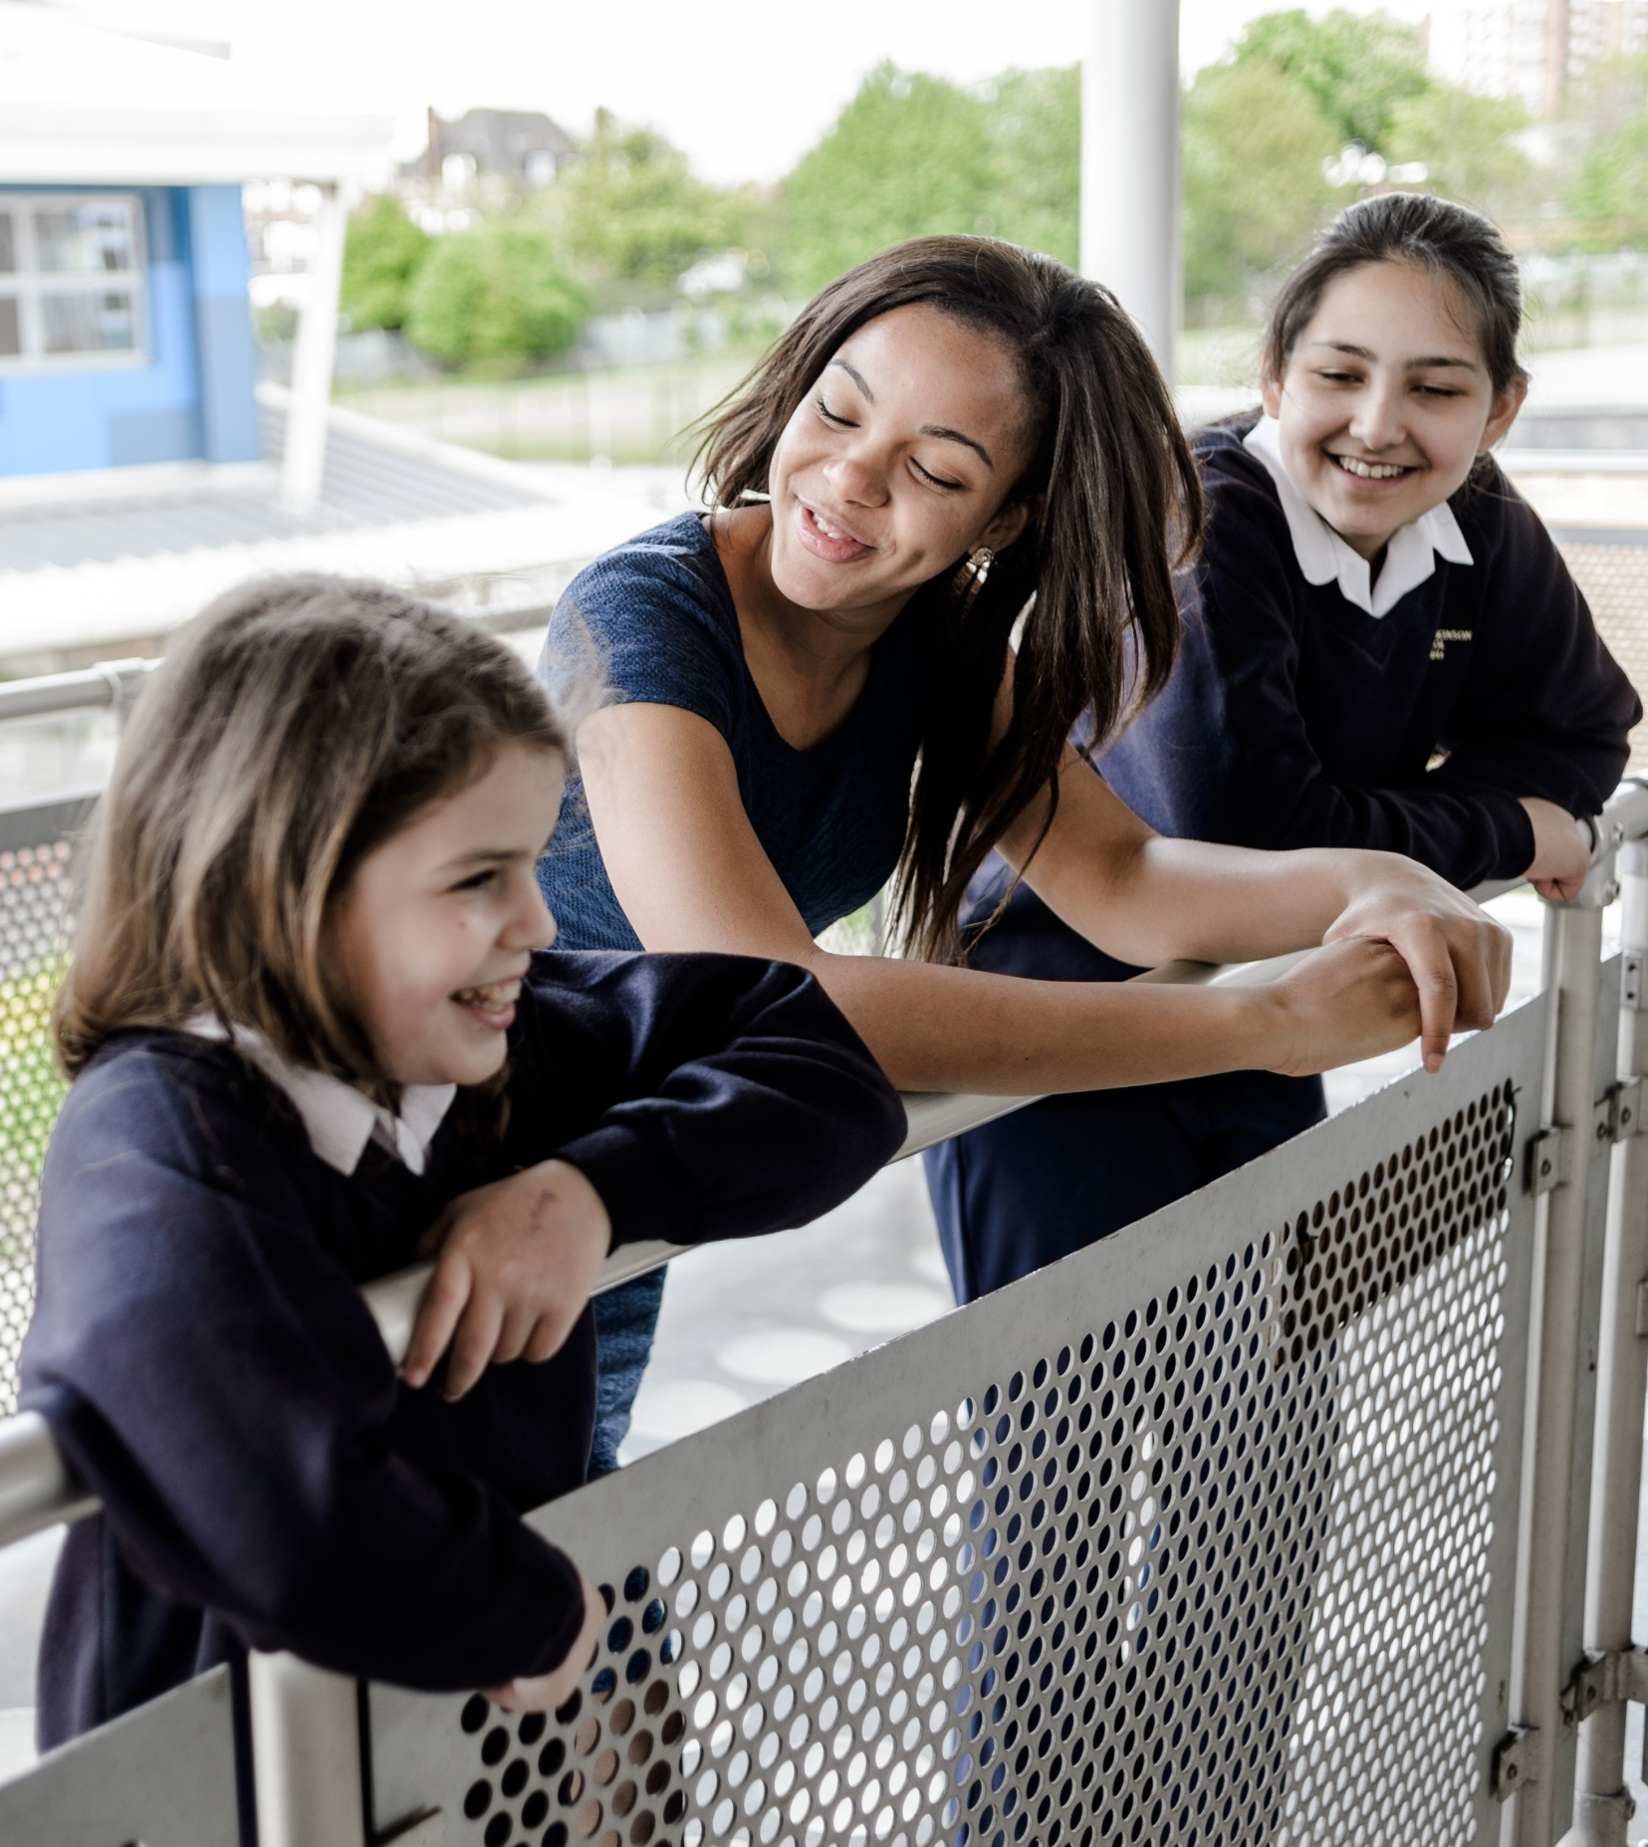

Slide 12
The Ellen Wilkinson School
For Girls
Queens Drive, London W3 0HW
0208 752 1525 | www.ellenwilkinson.ealing.sch.uk

Slide 13
The Ellen Wilkinson School
For Girls
Inspiring
Passionate
Nurturing
Successful
Creative
A Specialist College for
Science and Mathematics
The Ellen Wilkinson School for Girls is a high achieving, creative and vibrant school superbly located in the heart of Ealing, where girls receive the encouragement and support to become successful, determined and confident young women.
This year, the school achieved outstanding GCSE results including a
Progress 8 of +0.86 (Top in the Borough)
Teacher of Science
September Start – Full Time
MPS (Possibility of TLR)
We are seeking to recruit an outstanding and motivated Teacher of Science to contribute towards
the vision and effectiveness of a dedicated and successful department. You will join a team of
ambitious teaching professionals committed to offering a stimulating and innovative curriculum and
providing a consistently exceptional education for all girls at the school. The new post-holder would
experience fantastic professional development at a time of exciting growth throughout the school.
We are looking for someone who:
Is a creative, imaginative, innovative and experimental classroom practitioner
Is committed to further professional development
Is emotionally intelligent, embraces a growth mind set and is driven towards improvement
The Closing Date for the post is Monday 19th February 2018 at 12 noon.
Recruitment Pack and Application Forms can be obtained from www.ellenwilkinson.ealing.sch.uk/1321/vacancies or by contacting +44 (0)208 752 1525
Our school is committed to safeguarding and promoting the welfare of the children and expects all staff to share this commitment.

