Slide 1

The Ellen Wilkinson School
For Girls
HR Administrator
RECRUITMENT INFORMATION
A Specialist College for
Science & Mathematics

Slide 2


Slide 3







Background
T
he Ellen Wilkinson School for Girls aims to represent excellence, independence and empowerment in the education of women. The school is fortunate to employ over 200 staff, educate over
development between the moment they arrive at the school and the time they leave. Of course, our very top students perform exceptionally well and advance on to top universities across the country.
The Ellen Wilkinson girl, by the end of her time at the school, will have achieved outstanding personal success and have developed a genuine love of learning. She will continue her pursuit of education and excellence and will, above all else, leave confident and prepared to play a vital role in society – It is this anchor which underpins all of the work we do individually and collectively as a staff.
1,400 girls, and boast a 5,000m² site.
We are proud to provide a curriculum that is not only challenging and engaging to our students, but also creates the best opportunity for every woman in the school to become independent and confident to face the challenges of a complex and challenging world.
Our curriculum is developed with the interest of every
student at it’s core, with the primary purpose of ensuring they leave with the life skills to reach their potential and lead fulfilling lives. The rich curriculum we offer allows our students to thrive equally in academic and creative disciplines. This is complimented with an extensive range of extra curricular activities which are designed to enhance the students’ experience at every level.
We are united with our stakeholders by a strong sense of community and service, for the purpose of ensuring that all of our students make exceptional progress in their own unique ways. We are consistently amongst the top schools for value added; that is to say our students
demonstrate amongst the highest rates of growth and
Top 25% IN UK

Slide 4

The Role
HR Administrator
Post Title : Human Resources Administrator
Scale : NJC Scale 5, Point 22 approximately £21,000 : Inc. OLW + Ealing Supplement (pro rata)
Term time only: 35 hrs per week (39weeks per year)
Report to : Director of Operations and Finance
Main purpose of the job :
Providing a comprehensive administrative support to day to day operations of Human Resource support service to all existing and prospective employees of the school. This post has a probationary period of six months
Administrative responsibilities, duties and tasks
To ensure correct, complete, accurate and legally compliant personnel files are maintained within the agreed system and procedures.
To enter data into SIMS and maintain employee file records.
To be responsible for the maintenance and security of all HR records in the school.
To prepare, review and gather data and statistical reports for the school work force census and return accurate information to the appropriate bodies.
To manage the administration of the appraisal procedure for support staff and ensure that the 6 months probationary review of support staff are carried out.
To monitor employee appraisal reviews.
To be responsible for the production and maintenance of the HR Procedure Handbook.
To monitor staff attendance and regularly enter absence into SIMS.
To prepare OH referral forms for employees with long term absences.
To monitor scheduled absences such as holidays so that support staff absences are adequately covered to ensure continuous service.
Be responsible for photocopying Personnel records as appropriate

Slide 5
The Role
HR Administrator
Recruitment
To ensure that accurate job descriptions are in place.
To prepare notices and advertisements for vacant staff positions both internal and external.
To liaise with external agencies for advertising of vacant positions in the school.
To place adverts for vacant posts on the school website.
To schedule and organise interviews in liaison with the Head/Line Managers.
To prepare the relevant packs for the interview panel.
To administer pre-employment checks and tests as necessary.
To prepare and send ‘invitation to interview’ letters to candidates.
To conduct reference checks on possible candidates and volunteers.
To process data for all leaving staff.
To arrange and file leaver documentation for line managers, i.e. exit interviews, leaver’s questionnaire.
To maintain the spreadsheet on new appointments.
To maintain the leavers’ spreadsheet.
To approve new starter paperwork and input on personnel portal and on school SIMS systems.
To ensure terms and conditions and associated paperwork is sent to employees within 10 days of commencing employment, and confirmation of changes is sent within one month of the contractual changes. To ensure all paperwork is returned by all parties and procedure is in place and managed for non-returned paperwork.
To ensure all aspects of Safeguarding Recruitment is covered.
To obtain and file copies of qualifications and identification documents for all new appointments.
Liaise with Teacher agencies to obtain the references, identifications for long term and short term supply teachers.
To act as administration support for the NQT Manager System.
To ensure all NQT’s have the relevant paperwork in place, and to obtain and chase copies of all skills tests and NQT Certificates.
Employment of New Employees – Statutory Checks
To ensure all specific requirements for Disclosure Barring Service , Right to Work and any other requirements to safeguard the School with the employment of people working in the UK and with children are properly checked and kept on file as required.

Slide 6
The Role
HR Administrator
To input accurately and promptly DBS & Right to Work details including numbers, and expiry dates into the Single Central Record.
To manage expiry dates of Right to Work authorisations, ensuring appropriate parties are communicated with in a prompt and accurate manner in order to comply with the employment legislation.
To provide data to relevant parties on outstanding DBS.
To promptly bring to the attention of the Headteacher any significant issues that may lead to non-compliance with DBS and/or Right to Work legislation.
General
To Support the Staffing Committee of the Governors.
To act as Minutes Secretary for Capability, Grievance and Disciplinary hearings.
To maintain personal and professional development to meet the changing demands of the job
and participate in appropriate training activities.
To undertake health and safety duties commensurate with the post and/or as detailed in the
School’s Health and Safety Policy.
To undertake such other duties, training and/or hours of work as may be reasonably required
and which are consistent with the general level of responsibility of this job. To carry out other duties and responsibilities, of a similar administrative nature and at a similar responsibility level to those described above that may be allocated from time to time.
This is a Job Description only and is not necessarily a comprehensive definition of the post. It sets out the duties of the post at the time it was drawn up and should be seen as describing in more detail aspects of the duties set out in the Education Act (School Teachers’ Pay and Conditions of Employment) Order 1987 Schedule 3.
The Head of the School may vary the duties from time to time without changing their general character or the level of responsibility entailed. Any modification or amendment will be made after consultation with the holder of the post.
Our school is committed to safeguarding and promoting the welfare of the children and expects all staff to share this commitment

Slide 7

Post: Human Resources Administrator
Person Specification
 | Essential | Desirable
Qualifications | Sound general education to ‘A’ Level standard or equivalent. GCSE grade C or equivalent in Mathematics and English. | CIPD Qualification or studying for it.
Experience | Administrative background which can be applied to the needs of the role. | Experience of working in an HR and/or school environment. Experience of recruitment and selection processes e.g. placing adverts, setting up interviews, all related paperwork including issuing of contracts .
Ability/Skills | Excellent written and verbal communication skills able to communicate with people at all levels. Proven excellent organisational skills with ability to prioritise work. Ability to work with different databases and IT systems with first class ICT skills, eg Word, Excel. Ability to draft straightforward correspondence. Clear understanding of the confidential nature of HR work | Able to deal with a number of different situations in quick succession. Knowledge of HR policies and work within them. Good level of accuracy with an eye for detail.
Personal Qualities | Good team member able to establish effective working relationships. Excellent inter-personal skills, able to work constructively with all departments. Ability to work hard with competing deadlines, prioritising appropriately. Ability to work calmly under pressure. Trusted to act with integrity. Ability to work in a tactful and diplomatic manner. An interest in the world of Education. Resilience and sense of humour. Able to work independently and use initiative.
Equal Opportunities | Awareness of and commitment to equal opportunities. Ability to promote and support the school’s equal opportunities policy.

Slide 8
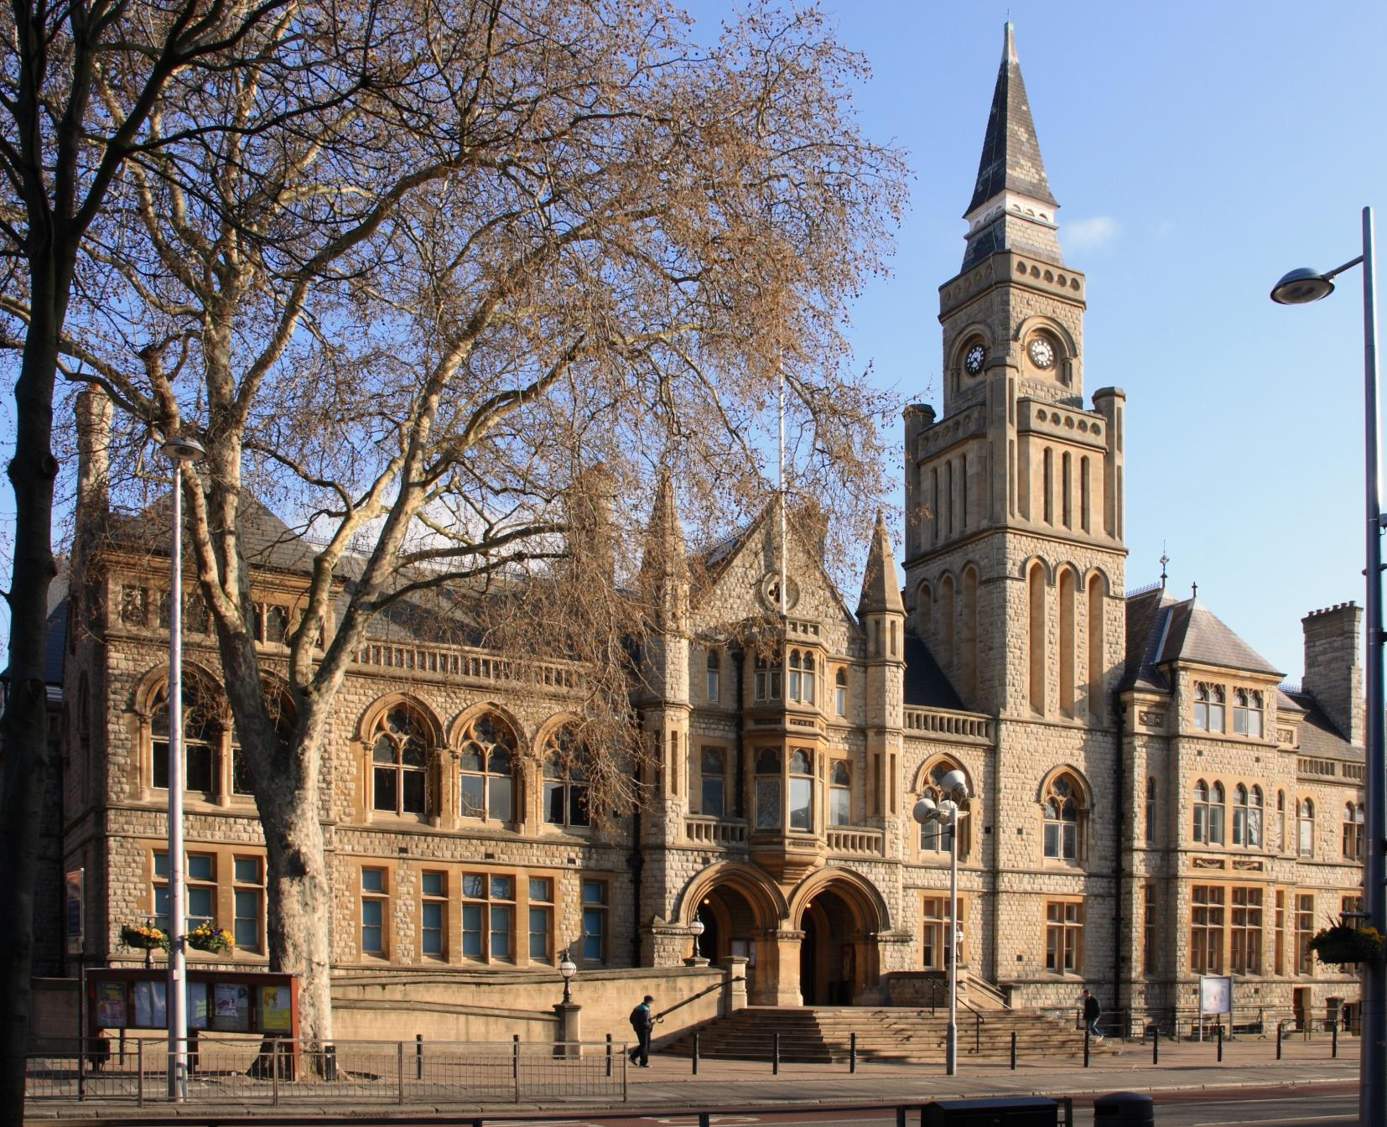
Living and working in Ealing
T
ransport
Tube: The school is a very short walking distance from West Acton Station (Central Line Zone 3) and North Ealing Station (Piccadilly Line Zone 3), offering
C
ulture and Amenities
Popular restaurants and bars include The Grapevine, The Grange, and Charlotte’s Place, historically winning the Good Food Guide Readers’ London Restaurant of the Year.
very short travel times to and from the West End and Westfield Shopping Centre.
Rail: First Great Western trains from Ealing Broadway and West Ealing to Paddington take just 10 to 15 minutes, with the Heathrow Connect service getting you to the airport in less than 30 minutes.
Bus: Ealing is served by an impressive number of bus routes, including the 65 (to Kingston), 83 (to Golders Green) and 297 (to Willesden).
Cycle: Proposals to build a Cycle Superhighway between Tower Hill and Acton could make life even easier for Ealing cyclists, who currently enjoy a 40 minute cycle to Hammersmith.
The borough enjoys its very own Blues, Jazz, Comedy and Beer festivals throughout the year.
Savvy shoppers in the area go to Ealing Broadway Shopping Centre which has most high street chains and just a little further away, to Westfield Shopping Centre.
The Pitshanger Bookshop is an Ealing institution and the independent store has been helping locals pick out their next must read for almost 20 years.
Ealing continues to prove itself as a perfect mix of green suburban charm and urban convenience and accessibility.

Slide 9

How to apply
T
he Ellen Wilkinson School for Girls seeks to appoint a HR Administrator to contribute towards the vision and effectiveness of a dedicated and successful school.
Applications should be submitted to the school office, via email, in the post or in person at:
Human Resources
The Ellen Wilkinson School for Girls
Queens Drive
West Acton
London
W3 0HW
office@ellenwilkinson.ealing.sch.uk
www.ellenwilkinson.ealing.sch.uk/vacancies
Closing date for applications is on Friday 5th January 2018 at noon. We will contact shortlisted applicants only.
The school is committed to safeguarding and promoting the welfare of children and young people and expects all staff and volunteers to share this commitment.
Successful applicants will be subject to an enhanced DBS check and medical questionnaire.

Slide 10


Slide 11
The Ellen Wilkinson School
For Girls
Queens Drive, London W3 0HW
0208 752 1525 | www.ellenwilkinson.ealing.sch.uk

Slide 12
The Ellen Wilkinson School
For Girls
Inspiring
Passionate
Nurturing
Successful
Creative
A Specialist College for
Science and Mathematics
The Ellen Wilkinson School for Girls is a high achieving, creative and vibrant school superbly located in the heart of Ealing, where girls receive the encouragement and support to become successful, determined and confident young women.
This year, the school achieved outstanding GCSE results by a way of:
• A Progress 8 Score of + 0.86
• An Attainment 8 of B-
• Value Added Score within the Top 7% in the country (Top 100 non-selective schools nationally)
HR Administrator
37.5 hours per week , Term time only (39 weeks per year)
Salary: NJC Scale 5, Point 22 approximately £21,000 pro rata (inclusive of allowances)
This post has a probationary period of six months
This is a key role in supporting the day-to-day running of the school and the successful applicant must be IT Literate and competent in using a variety of software packages. Duties include:
Providing a comprehensive administrative support to day to day operations of Human Resource support service to all existing and prospective employees of the school.
You must be a pleasant and willing individual with the ability to remain calm and cheerful under pressure.
Closing Date for the post is Friday 5th January 2018 at noon
Recruitment Pack and Application Forms can be obtained from www.ellenwilkinson.ealing.sch.uk/vacancies or by contacting +44 (0)208 752 1525
Our school is committed to safeguarding and promoting the welfare of children and young people and requires all staff to share this commitment This post is subject to an Enhanced Disclosure Application to the Disclosure and Barring Service.

