Slide 1

The Ellen Wilkinson School
For Girls
Teacher of Maths
RECRUITMENT INFORMATION
A Specialist College for
Science & Mathematics

Slide 2


Slide 3







Background
T
he Ellen Wilkinson School for Girls aims to represent excellence, independence and empowerment in the education of women. The school is fortunate to employ over 200 staff, educate over
development between the moment they arrive at the school and the time they leave. Of course, our very top students perform exceptionally well and advance on to top universities across the country.
The Ellen Wilkinson girl, by the end of her time at the school, will have achieved outstanding personal success and have developed a genuine love of learning. She will continue her pursuit of education and excellence and will, above all else, leave confident and prepared to play a vital role in society – It is this anchor which underpins all of the work we do individually and collectively as a staff.
1,400 girls, and boast a 5,000m² site.
We are proud to provide a curriculum that is not only challenging and engaging to our students, but also creates the best opportunity for every woman in the school to become independent and confident to face the challenges of a complex and challenging world.
Our curriculum is developed with the interest of every
student at it’s core, with the primary purpose of ensuring they leave with the life skills to reach their potential and lead fulfilling lives. The rich curriculum we offer allows our students to thrive equally in academic and creative disciplines. This is complimented with an extensive range of extra curricular activities which are designed to enhance the students’ experience at every level.
We are united with our stakeholders by a strong sense of community and service, for the purpose of ensuring that all of our students make exceptional progress in their own unique ways. We are consistently amongst the top schools for value added; that is to say our students
demonstrate amongst the highest rates of growth and
Top 25% IN UK

Slide 4
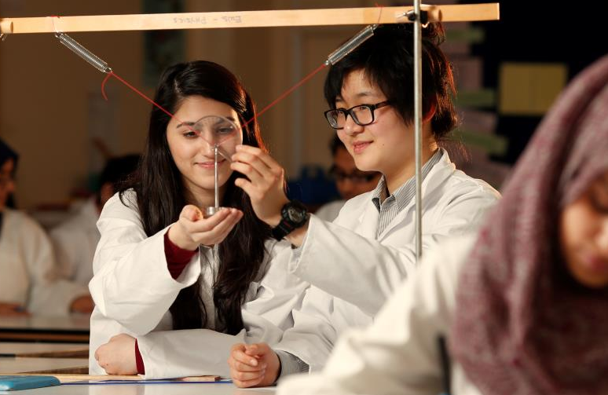
The Role
Teacher of Maths
Job Title: Teacher of Maths
Report To: Head of Department
Salary Range: EWS Teachers’ Pay Scale (MPS)
Supervisory Responsibility: The post holder may be responsible may be responsible for the deployment and supervision of the work of Teaching Assistants relevant to their responsibilities.
1. Purpose of the job
• To facilitate and encourage learning which enables pupils to achieve the highest possible standards;
• To share and support the responsibility for the education, well-being and safety of all pupils;
• To meet all of the Teachers’ Standards (2012)
2. Job context
The school welcomes teachers of high professional standards and shares the responsibility with each teacher for continual review and the development of expertise.
All teachers make a valuable contribution to the school’s development and, therefore, to the progress of all pupils. They are role models to pupils and -at all times- the values, vision and ethos of the school must be evident in their attitude and behaviour. They treat pupils with dignity, building relationships rooted in mutual respect, and at all times observing proper boundaries appropriate to a teacher’s professional position.
They are responsible and accountable for achieving the highest possible standards in work and conduct. They are also responsible for the learning and achievement of all pupils in the class/es ensuring equality of opportunity for all.
Teachers must be proactive in ensuring the school’s Health and Safety Policy and safeguarding of pupils are implemented both on and off school premises and when engaged in authorised school activities elsewhere.

Slide 5
The Role
Teacher of Maths
3. School Culture
Teachers are expected:
To help create a strong community, characterised by consistent, orderly, caring and respectful relationships;
To help develop a culture and ethos that is committed to achievement and the principles of equal opportunities;
To adhere to the policies and procedures of the school, in particular, those of Safeguarding, Teaching and Learning, Assessment Recording and Reporting and Health and Safety;
To make a positive contribution to the wider life and ethos of the school;
To take a full part in enrichment and enhancement activities in and beyond the school;
To create and sustain a positive class culture;
To promote the achievement of each individual pupil by setting appropriate goals and promoting high standards of achievement in work and behaviour;
To challenge behaviour that is not in line with school policy;
To keep up-to-date and adhere to the current school and national policies and procedures.
4. Pastoral Care
Teachers are expected:
To care for each pupil as an individual and ensure that they have the opportunities to succeed academically and develop emotionally and socially;
To provide relevant guidance to pupils on educational and social matters and on further education and future careers;
To teach relevant issues;
To liaise with relevant colleagues, including line managers;
Under the direction of a line manager, to maintain contact with parents and external services.
To perform the role of a form tutor.

Slide 6
The Role
Teacher of Maths
5 .Teaching & Learning
Teachers are expected:
To teach the classes and groups assigned with due regard to the National Curriculum, the Curriculum of the School and the Schemes of Work of the Department. This includes planning and preparation of courses and lessons, setting of homework and marking of work carried out by pupils;
To continue the development, successful delivery and assessment of all courses which form a key part of the Department’s curriculum, and the requirements of Citizenship, SMSC and Fundamental British Values;
To take part in the review, development and evaluation procedures relating to the department, PSHEE and other relevant curriculum areas;
To be accountable for the attainment, progress and outcomes of pupils’ taught;
To be aware of pupils’ capabilities, their prior knowledge and plan teaching and differentiate appropriately to build on these demonstrating knowledge and understanding of how pupils learn;
To have a clear understanding of the needs of all pupils, including those with special educational needs; gifted and talented; EAL; disabilities; and be able to use and evaluate distinctive teaching approaches to engage and support them;
To demonstrate an understanding of and take responsibility for promoting high standards of literacy including the correct use of spoken English , whatever the specialist subject;
To use an appropriate range of observation, assessment, monitoring and recording strategies as a basis for setting challenging learning objectives for pupils of all backgrounds, abilities and dispositions, monitoring learners’ progress and levels of attainment;
To make accurate and productive use of assessment to secure pupils’ progress;
To give pupils regular feedback, both orally and through accurate marking, and encourage pupils to respond to the feedback, reflect on progress, their emerging needs and to take a responsible and conscientious attitude to their own work and study;
To use relevant data to monitor progress, set targets, and plan subsequent lessons;
To set homework and plan other out-of-class activities to consolidate and extend the knowledge and understanding pupils have acquired as appropriate;
To participate in arrangements for examinations and assessments within the remit of the School Teachers’ Pay and Conditions Document

Slide 7
The Role
Teacher of Maths
6. Professional Development
Teachers are expected:
To regularly review the effectiveness of y teaching and assessment procedures and its impact on pupils’ progress, attainment and well- being, refining approaches where necessary and responding to advice and feedback from colleagues;
To be responsible for improving teaching through participating fully in training and development opportunities identified by the school or as developed as an outcome of appraisal;
To proactively participate with arrangements made in accordance with the Appraisal Regulations 2012;
To keep abreast of current developments in the main and any subsidiary subject as appropriate, with particular reference to National Curriculum criteria;
To take a full part in all professional development opportunities provided by the school.
7. Wider professional responsibilities
Teachers are expected:
To deploy support staff effectively as appropriate;
To carry out duties as directed and within the remit of the current School Teachers’ Pay and Conditions Document;
To work collaboratively with others to develop effective professional relationships;
To maintain high standards in own attendance and punctuality.
Note
This job description is not a contract of employment or any part of it. It has been prepared only for the purpose of school organisation and may change either as a contract changes or as the organisation of the school is changed. Nothing will be changed without consultation.
This is a Job Description only and is not necessarily a comprehensive definition of the post. It sets out the duties of the post at the time it was drawn up and should be seen as describing in more detail aspects of the duties set out in the Education Act (School Teachers’ Pay and Conditions of Employment) Order 1987 Schedule 3.
The Head of the School may vary the duties from time to time without changing their general character or the level of responsibility entailed. Any modification or amendment will be made after consultation with the holder of the post.
Our school is committed to safeguarding and promoting the welfare of the children and expects all staff to share this commitment.

Slide 8

The Person Specification
Please make sure, when completing your application form, that you give clear examples of how you meet the criteria.
Essential Qualification Criteria
All applicants must:
Be deemed suitable to work with children
Be qualified to degree level or above
Be eligible to teach in the UK
Be eligible to the right to work in the UK
Have a good command of spoken and written Standard English.
Experience: Teaching/training at secondary school level Working/training in a multicultural environment
Knowledge: Have in depth knowledge of main teaching subject Have up-to-date knowledge of current educational developments in relation to that subject at whole school level Have awareness of current approaches and teaching strategies in main subject and any other subject offered Be vigilant regarding Safeguarding

Slide 9
Skills: Ability to engender enthusiasm for the teaching subject(s) and motivating pupils through setting purposeful work Ability to encourage learners to develop self-esteem. To keep themselves and others safe and to have respect for others Ability to plan and deliver high quality lessons, evaluate the impact of these and develop future planning accordingly Ability to promote high standards of achievement in work and behaviour Ability to teach across the whole ability and age range of the school Show a clear grasp of Assessment, Recording and Reporting (including target setting) Ability to use new technology to support both the curriculum and organisation Ability to monitor and evaluate teaching and learning and act upon the outcomes, including data analysis Ability to assess the needs of individuals to inform lesson planning Ability to prioritise, pay meticulous attention to detail, work under pressure and meet strict deadlines QUALITIES To show willingness (and/ or experience of) to foster good relationships with all the school’s stakeholders To demonstrate commitment to team work and collaboration, including assisting in To be hardworking, determined and conscientious To be a reflective practitioner, able to self-evaluate and develop professionally

Slide 10
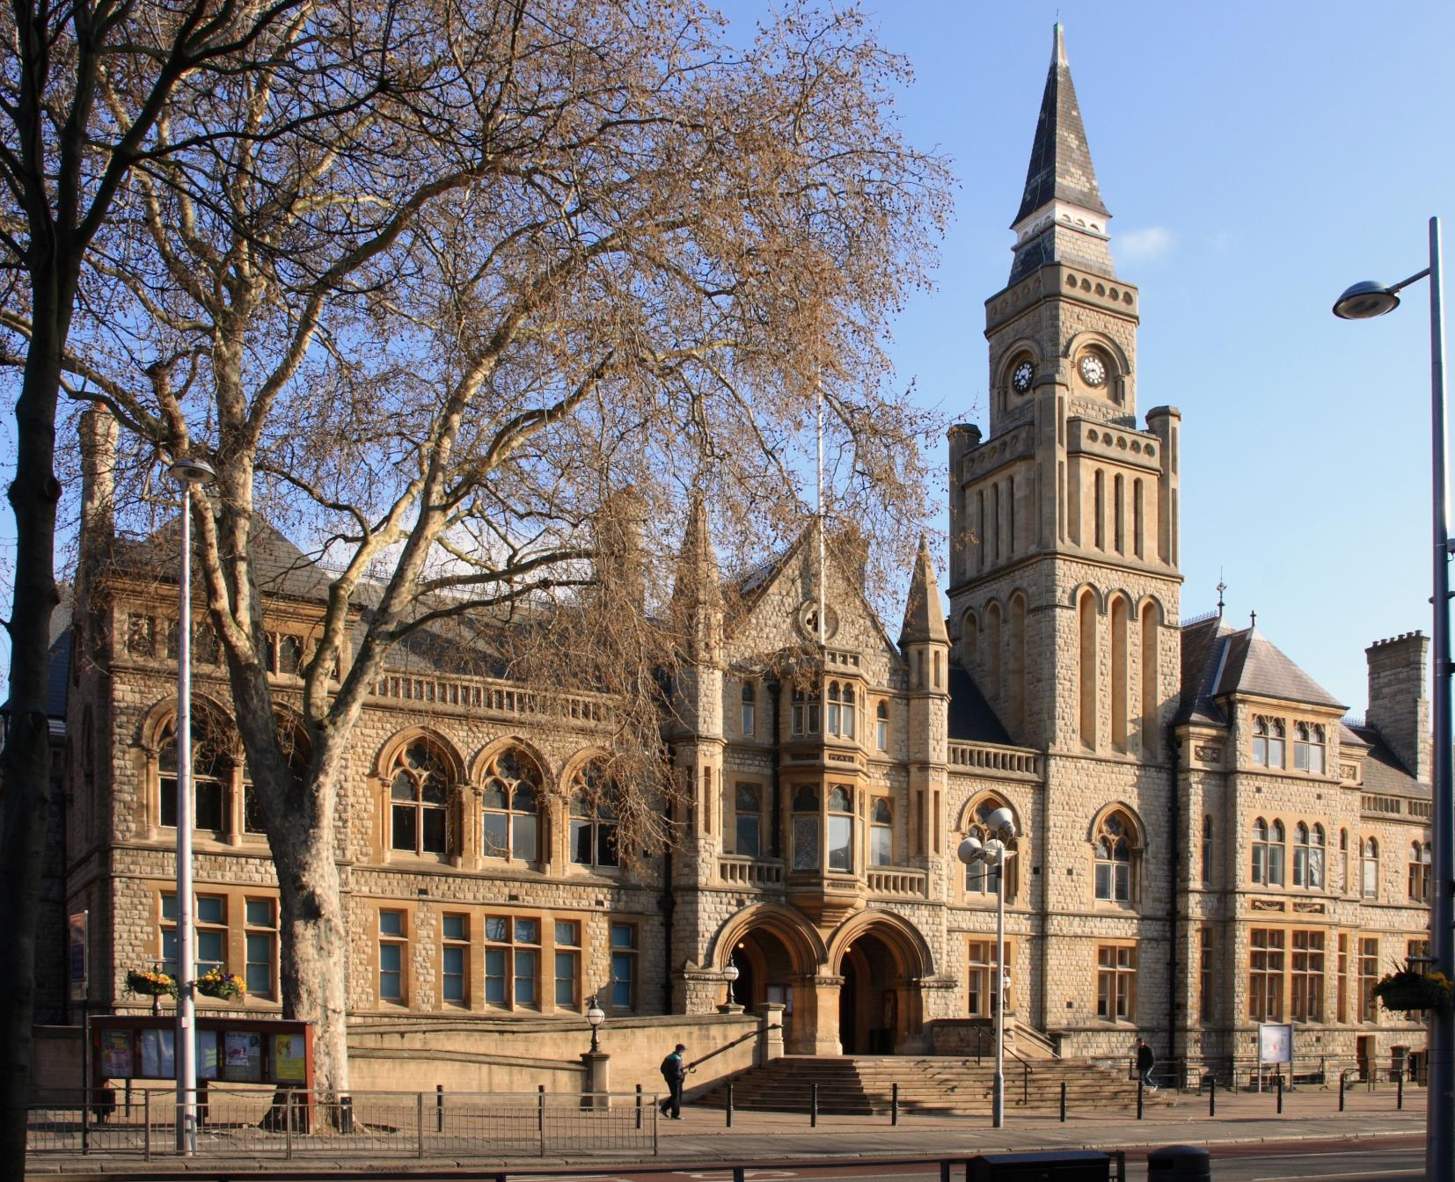
Living and working in Ealing
T
ransport
Tube: The school is a very short walking distance from West Acton Station (Central Line Zone 3) and North Ealing Station (Piccadilly Line Zone 3), offering
C
ulture and Amenities
Popular restaurants and bars include The Grapevine, The Grange, and Charlotte’s Place, historically winning the Good Food Guide Readers’ London Restaurant of the Year.
very short travel times to and from the West End and Westfield Shopping Centre.
Rail: First Great Western trains from Ealing Broadway and West Ealing to Paddington take just 10 to 15 minutes, with the Heathrow Connect service getting you to the airport in less than 30 minutes.
Bus: Ealing is served by an impressive number of bus routes, including the 65 (to Kingston), 83 (to Golders Green) and 297 (to Willesden).
Cycle: Proposals to build a Cycle Superhighway between Tower Hill and Acton could make life even easier for Ealing cyclists, who currently enjoy a 40 minute cycle to Hammersmith.
The borough enjoys its very own Blues, Jazz, Comedy and Beer festivals throughout the year.
Savvy shoppers in the area go to Ealing Broadway Shopping Centre which has most high street chains and just a little further away, to Westfield Shopping Centre.
The Pitshanger Bookshop is an Ealing institution and the independent store has been helping locals pick out their next must read for almost 20 years.
Ealing continues to prove itself as a perfect mix of green suburban charm and urban convenience and accessibility.

Slide 11
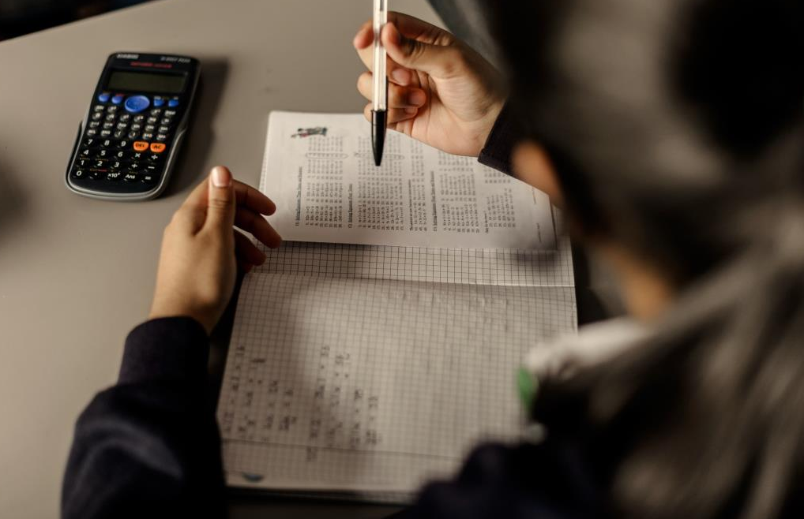
How to apply
T
he Ellen Wilkinson School for Girls seeks to appoint a Learning Support Assistant to contribute towards the vision and effectiveness of a dedicated and successful school.
Applications should be submitted to the office, via email, in the post or in person at:
HR Administrator
The Ellen Wilkinson School for Girls
Queens Drive
West Acton
London
W3 0HW
office@ellenwilkinson.ealing.sch.uk
www.ellenwilkinson.ealing.sch.uk/1321/vacancies
Closing date for applications is on Monday 5th February 2018 at 12 noon. We will contact shortlisted applicants only.
The school is committed to safeguarding and promoting the welfare of children and young people and expects all staff and volunteers to share this commitment.
Successful applicants will be subject to an enhanced DBS check and medical questionnaire.

Slide 12
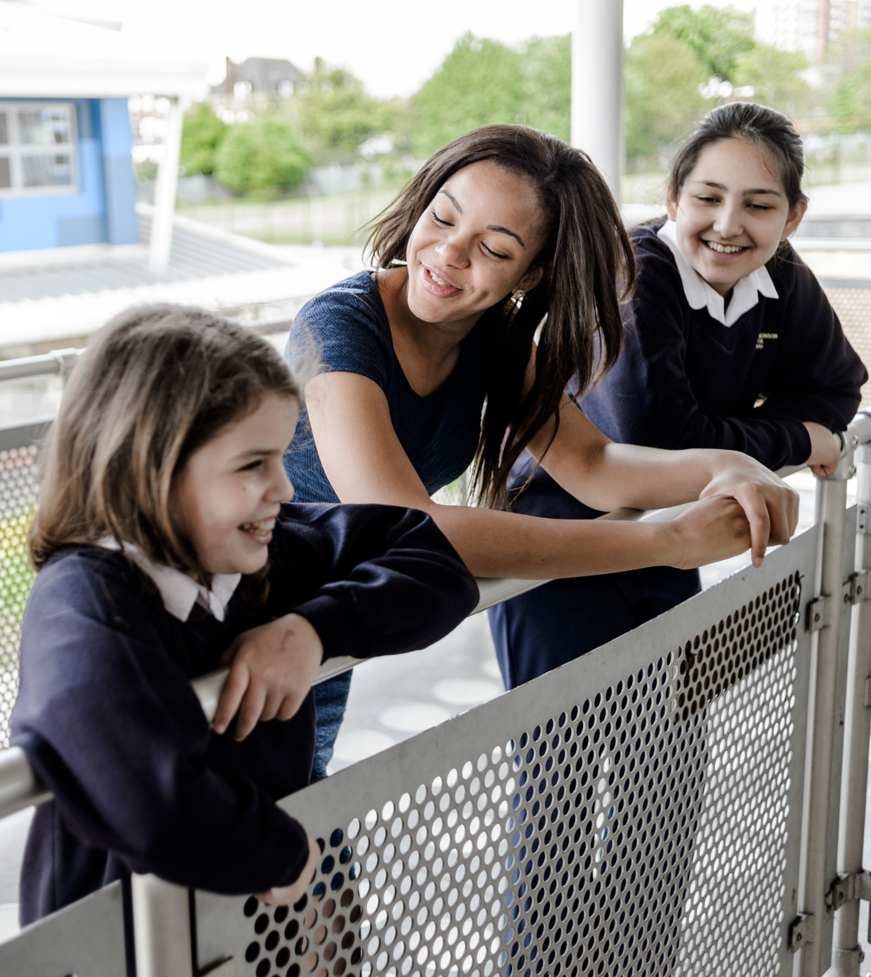

Slide 13
The Ellen Wilkinson School
For Girls
Queens Drive, London W3 0HW
0208 752 1525 | www.ellenwilkinson.ealing.sch.uk

Slide 14
The Ellen Wilkinson School
For Girls
Inspiring
Passionate
Nurturing
Successful
Creative
A Specialist College for
Science and Mathematics
The Ellen Wilkinson School for Girls is a high achieving, creative and vibrant school superbly located in the heart of Ealing, where girls receive the encouragement and support to become successful, determined and confident young women.
This year, the school achieved outstanding GCSE results including a
Progress 8 of +0.86 (Top in the Borough)
Teacher of Maths
September Start - Full Time
MPS
We are seeking to recruit an outstanding and motivated Teacher of Maths to contribute towards the vision and effectiveness of a dedicated and successful department. You will join a team of ambitious teaching professionals committed to offering a stimulating and innovative curriculum and providing a consistently exceptional education for all girls at the school. The new post-holder would experience fantastic professional development at a time of exciting growth throughout the school.
We are looking for someone who:
Is a creative, imaginative, innovative and experimental classroom practitioner
Is committed to further professional development
Is emotionally intelligent, embraces a growth mind set and is driven towards improvement
The Closing Date for the post is Monday 5th February 2018 at 12 noon.
Recruitment Pack and Application Forms can be obtained from www.ellenwilkinson.ealing.sch.uk/1321/vacancies or by contacting +44 (0)208 752 1525
Our school is committed to safeguarding and promoting the welfare of the children and expects all staff to share this commitment.

