Slide 1

The Ellen Wilkinson School
For Girls
Data Administrator
RECRUITMENT INFORMATION
A Specialist College for
Science & Mathematics

Slide 2


Slide 3







Background
T
he Ellen Wilkinson School for Girls aims to represent excellence, independence and empowerment in the education of women. The school is fortunate to employ over 200 staff, educate over
development between the moment they arrive at the school and the time they leave. Of course, our very top students perform exceptionally well and advance on to top universities across the country.
The Ellen Wilkinson girl, by the end of her time at the school, will have achieved outstanding personal success and have developed a genuine love of learning. She will continue her pursuit of education and excellence and will, above all else, leave confident and prepared to play a vital role in society – It is this anchor which underpins all of the work we do individually and collectively as a staff.
1,400 girls, and boast a 5,000m² site.
We are proud to provide a curriculum that is not only challenging and engaging to our students, but also creates the best opportunity for every woman in the school to become independent and confident to face the challenges of a complex and challenging world.
Our curriculum is developed with the interest of every
student at it’s core, with the primary purpose of ensuring they leave with the life skills to reach their potential and lead fulfilling lives. The rich curriculum we offer allows our students to thrive equally in academic and creative disciplines. This is complimented with an extensive range of extra curricular activities which are designed to enhance the students’ experience at every level.
We are united with our stakeholders by a strong sense of community and service, for the purpose of ensuring that all of our students make exceptional progress in their own unique ways. We are consistently amongst the top schools for value added; that is to say our students
demonstrate amongst the highest rates of growth and
Top 25% IN UK

Slide 4
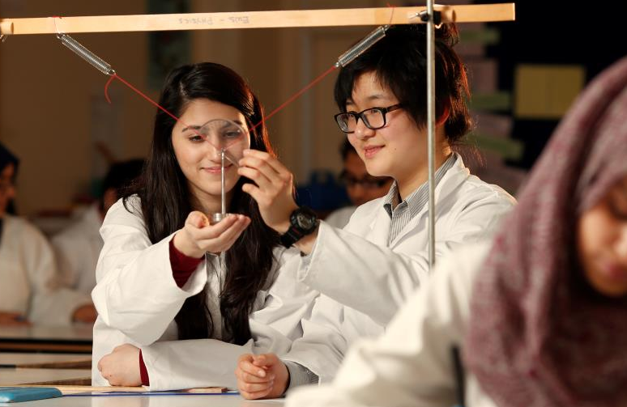
The Role
Data Administrator
Post Title: Data Administrator
Report to: Under the direction of the Assistant Headteacher in charge of Assessment
Salary: NJC Scale 4 Point 18 pro rata (approximately £9,500 per annum Inclusive of allowances)
Hours: 20 hours per week, term time only 39 weeks per year
The post has a probationary period of six months.
Duties and Responsibilities include:-
To help manage the School Information Management System (SIMS) Assessment module. This will include setting up aspects, results sets, grade sets, templates, mark sheets, analysis templates as well as amending, deleting and updating data.
To help manage the assessment, recording and reporting cycle and briefing staffing. This will include setting up individual reports templates and mark sheets; communicating with Head of Departments and teachers; helping to ensure that deadlines are met; preparing full reports and interim reports; liaising with the main school office; chasing missing entries; sending files to the Sims Learning Gateway and linked documents to SIMS.
To enter all baseline data e.g. KS2 results and CAT results into SIMS and into the school intranet assessment folder and to enter baseline data for any new pupil.
To identify any data omissions and to liaise with the LA or national data base to obtain missing data.
To collate and prepare data and information as required for returns to outside organisations including the local authority and DFE. This includes the School Census (3 times a year), Learning Aims, the End of KS3 assessments and the Background Data Report.
To communicate baseline data in forms required by members of the Senior Leadership Team and the Heads of Department.

Slide 5
The Role
Data Administrator
To assist with the management of data management software including RAISE Online, SISRA and FFTAspire. This will involve communicating with the Senior Leadership Team and Head of Departments.
To import KS4 targets from external databases to SIMS and to enter KS3 and KS5 targets.
To keep abreast with developments in data management e.g. SIMS Discover.
To ensure that the correct course details (QAN code etc.) are entered onto SIMS.
To invigilate internal and external examinations
All staff in school will be expected to accept the reasonable flexibility in working arrangements and the allocation of duties to reflect changing roles and responsibilities. Any changes will take account of salary/status/hours and will be subject to discussion, in accordance with the guidance note on contractual changes.
This is a Job Description only and is not necessarily a comprehensive definition of the post. It sets out the duties of the post at the time it was drawn up and should be seen as describing in more detail aspects of the duties set out in the Education Act (School Teachers’ Pay and Conditions of Employment) Order 1987 Schedule 3.
The Head of the School may vary the duties from time to time without changing their general character or the level of responsibility entailed. Any modification or amendment will be made after consultation with the holder of the post.
Our school is committed to safeguarding and promoting the welfare of the children and expects all staff to share this commitment

Slide 6

The Person Specification
A good level of technical ability is required. Equally important are a reasonable level of common sense, an attention to detail and an ability to work quickly and efficiently.
Qualifications
Educated to A Level, BTEC National or higher.
Experience
Familiarity and expertise with SIMS, Excel, Word and Access or the ability to gain expertise in these similar pieces of software.
Evidence of methodical, systematic, organised approach to the completion of tasks.
Special Aptitudes
Ability to work quickly, neatly and accurately, and to take pride in the appearance and presentation of work produced.
Meticulous attention to detail
Ability to get on with staff and pupils.
Ability to work in a multi-ethnic environment.
Ability to use initiative and to problem solve.
Ability to keep deadlines.
Patience, tact and perseverance
Excellent communication skills
Personal Qualities
A pleasant and willing disposition
Ability to remain calm and cheerful under pressure.
Equal Opportunities
Awareness of and commitment to equal opportunities, ability to promote and support the school’s equal opportunities policy.

Slide 7
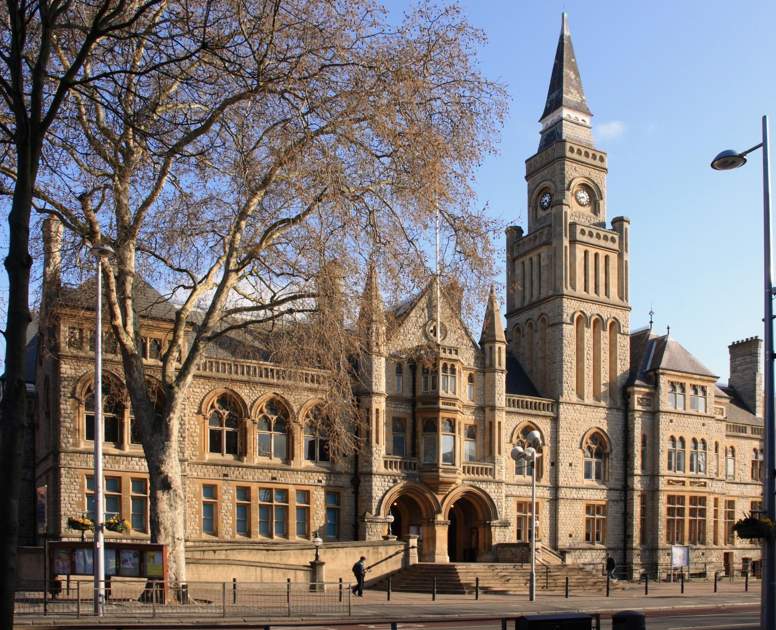
Living and working in Ealing
T
ransport
Tube: The school is a very short walking distance from West Acton Station (Central Line Zone 3) and North Ealing Station (Piccadilly Line Zone 3), offering
C
ulture and Amenities
Popular restaurants and bars include The Grapevine, The Grange, and Charlotte’s Place, historically winning the Good Food Guide Readers’ London Restaurant of the Year.
very short travel times to and from the West End and Westfield Shopping Centre.
Rail: First Great Western trains from Ealing Broadway and West Ealing to Paddington take just 10 to 15 minutes, with the Heathrow Connect service getting you to the airport in less than 30 minutes.
Bus: Ealing is served by an impressive number of bus routes, including the 65 (to Kingston), 83 (to Golders Green) and 297 (to Willesden).
Cycle: Proposals to build a Cycle Superhighway between Tower Hill and Acton could make life even easier for Ealing cyclists, who currently enjoy a 40 minute cycle to Hammersmith.
The borough enjoys its very own Blues, Jazz, Comedy and Beer festivals throughout the year.
Savvy shoppers in the area go to Ealing Broadway Shopping Centre which has most high street chains and just a little further away, to Westfield Shopping Centre.
The Pitshanger Bookshop is an Ealing institution and the independent store has been helping locals pick out their next must read for almost 20 years.
Ealing continues to prove itself as a perfect mix of green suburban charm and urban convenience and accessibility.

Slide 8

How to apply
T
he Ellen Wilkinson School for Girls seeks to appoint a Learning Support Assistant to contribute towards the vision and effectiveness of a dedicated and successful school.
Applications should be submitted to the office, via email, in the post or in person at:
HR Administrator
The Ellen Wilkinson School for Girls
Queens Drive
West Acton
London
W3 0HW
office@ellenwilkinson.ealing.sch.uk
www.ellenwilkinson.ealing.sch.uk/1321/vacancies
Closing date for applications is on Monday 19th February 2018 at 12 noon. We will contact shortlisted applicants only.
The school is committed to safeguarding and promoting the welfare of children and young people and expects all staff and volunteers to share this commitment.
Successful applicants will be subject to an enhanced DBS check and medical questionnaire.

Slide 9
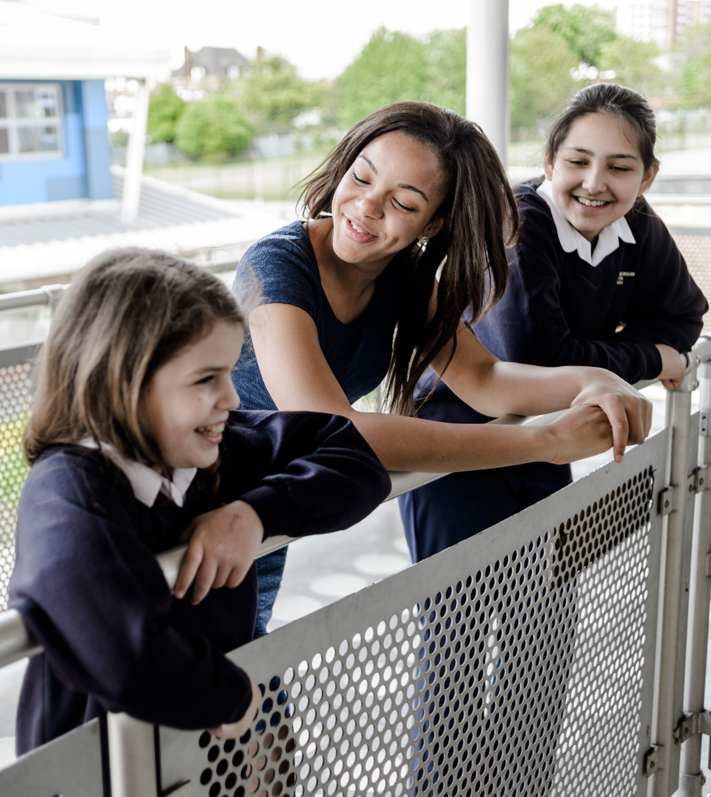

Slide 10
The Ellen Wilkinson School
For Girls
Queens Drive, London W3 0HW
0208 752 1525 | www.ellenwilkinson.ealing.sch.uk

Slide 11
The Ellen Wilkinson School
For Girls
Inspiring
Passionate
Nurturing
Successful
Creative
A Specialist College for
Science and Mathematics
The Ellen Wilkinson School for Girls is a high achieving, creative and vibrant school superbly located in the heart of Ealing, where girls receive the encouragement and support to become successful, determined and confident young women.
This year, the school achieved outstanding GCSE results including a
Progress 8 of +0.86 (Top in the Borough)
Data Administrator
20 hours per week, term time only, 39 weeks per year
Salary: NJC Scale 4 Point 18 pro rata (approximately £9500 per annum Inclusive of allowances)
This post has a probationary period of six months
An exciting opportunity has arisen for a Data Administrator within our school. We are looking for a well-qualified, motivated and experienced individual to take on this rewarding and fulfilling role.
We would like to hear from you if you have recent experience working within a Secondary school setting. You will need to have the skills to meet the range of needs of our SEN pupils and ensure that your input makes a difference to their confidence, progress and achievement in school.
You must be a pleasant and willing individual with the ability to remain calm and cheerful under pressure.
Closing Date for the post is Monday 19th February 2018 at 12 noon.
Recruitment Pack and Application Forms can be obtained from www.ellenwilkinson.ealing.sch.uk/1321/vacancies or by contacting +44 (0)208 752 1525

